Slide 1
Quarterly Revenue Insights – SuperKart
Model Deployment: Post Graduate AI/ML Business Applications
Date: Aug 7, 2025

Slide 2
Contents / Agenda
Executive Summary
Business Problem Overview and Solution Approach
EDA Results
Data Preprocessing
Model Building
Model Performance Summary
Deployment

Slide 3
Executive Summary
Please mention actionable insights & recommendations

Slide 4
Executive Summary
Please mention actionable insights & recommendations

Slide 5
Business Problem Overview and Solution Approach
SuperKart, a nationwide retail chain with a presence in both metropolitan and tiered cities, offers a diverse portfolio of products through its supermarkets and food marts. To enhance inventory efficiency and inform region-specific sales strategies, the organization seeks to accurately forecast outlet-level revenue for the upcoming quarter.
To scale these insights across its operations, SuperKart has engaged a data science consultancy to deliver more than just a predictive model. The partnership aims to design and implement a comprehensive forecasting solution—leveraging historical sales data—that seamlessly integrates with SuperKart’s enterprise decision-making systems and supports data-driven planning across its entire store network.
Accurate sales forecasting plays a critical role in optimizing sales operations by region and delivering actionable insights to the supply chain team for procurement planning. A well-structured forecasting process supports improved decision-making, mitigates risks in the sales pipeline, and streamlines territory coverage planning. Additionally, it enables the establishment of performance benchmarks that help identify and assess emerging trends, driving long-term strategic value.

Slide 6
Business Problem Overview and Solution Approach
Insight
Product weight - The presence of outliers suggests that some products are significantly lighter or heavier than the typical range, which may warrant further investigation (e.g., specialty items, packaging anomalies).
Product weight normal-like distribution implies that statistical modeling (e.g., regression or clustering) using may benefit from standard assumptions like Gaussianity.
Produced Allocated Area with the presence of outliers suggests a few products dominate shelf space disproportionately.
Produced Allocated Area reference line at 0.05 represents a target allocation, threshold for premium placement, or benchmark for analysis.
Product MRP identifies pricing clusters and anomalies that supports decisions on price segmentation, discount targeting, or inventory planning
Some Products MRP are priced significantly higher or lower than the norm which are indicated as outliers
OUT001 is a store of Supermarket Type 1 which is located in a Tier 2 city and has store size as high. It was established in 1987.
OUT001 has sold products whose MRP range from 71 to 227.
Snack Foods have been sold the highest number of times in OUT001.
The revenue generated from each product at OUT001 ranges from 2300 to 5000
OUT001 has generated the highest revenue from the sale of fruits and vegetables and snack foods. Both the categories have contributed around 800000 each.

Slide 7
Business Problem Overview and Solution Approach
OUT002 is a food mart which is located in a Tier 3 city and has store size as small. It was established in 1998.
OUT002 has sold products whose MRP range from 31 to 225.
Fruits and vegetables have been sold the highest number of times in OUT002.
The revenue generated from each product at OUT002 ranges from 33 to 2300.
OUT003 is a Departmental store which is located in a Tier 1 city and has store size as medium. It was established in 1999.
OUT003 has sold products whose MRP range from 86 to 266.
Snack Foods have been sold the highest number of times in OUT003.
The revenue generated from each product at OUT003 ranges from 3070 to 8000.
OUT004 is a store of Supermarket Type2 which is located in a Tier 2 city and has store size as medium. It was established in 2009.
OUT004 has sold products whose MRP range from 83 to 198.
Fruits and vegetables have been sold the highest number of times in OUT004.
The revenue generated from each product at OUT004 ranges from 1561 to 5463.
Sales normalization - Normalize sales within each product type to isolate demand vs stock levels.
Forecasting - Track category share over time — e.g., rising "Low Sugar" trend may indicate future product positioning.
Business Implications
Assortment planning: Lighter, low/no sugar items can be optimized for top-shelf placement and multi-pack bundling.
Marketing strategy: Target “No Sugar” with health-conscious promos; account for standardized weights in logistics.
Demand forecasting: Segment forecasts by sugar content—consumer behavior may vary across those groups.

Slide 8
Business Problem Overview and Solution Approach
Insight
Potential for location-based feature impact
Product preferences, sales behavior, and inventory flow may vary sharply between tiers.
Business strategy cues
Tier 1 stores may carry premium assortments or benefit from brand awareness.
Tier 3 stores may require more localized assortments or pricing strategies.
Operational implications
OUT004 may serve broader customer segments, carry wider assortments, or experience higher throughput.
Medium-sized stores might reflect the chain’s baseline operating model.
Departmental Stores: broader assortments could benefit from more complex inventory models.
Food Marts: quick-turn goods may need real-time or daily-level prediction granularity.
Target is dominated by price and pack size, age matters modestly, and allocated area (as-is) isn’t pulling its weight.

Slide 9
Business Problem Overview and Solution Approach
Heavier = Higher sales: Heavier products are likely larger packs or bulk formats, which generate more revenue per unit. This aligns with market behavior where larger SKUs typically drive higher gross sales.
Pricing and pack-size synergy: This trend is often confounded with Product_MRP — heavier items tend to cost more, so unit sales and revenue contributions increase concurrently.
Potential outliers: The handful of products above 20 in weight with extreme sales values warrant attention — check if they represent promotional events, seasonal items, or data entry artifacts.
Variance grows with price
Dispersion widens at higher MRP: some pricey items sell a lot, others much less.
If Product_Store_Sales_Total is revenue, high MRP driving higher totals is expected.
Low performers
Breakfast items and Hard Drinks generate the least revenue. Possible reasons:
Limited shelf space or SKUs.
Niche or seasonal demand.
Price elasticity or lower margin.

Slide 10
Business Problem Overview and Solution Approach
Low Performer
Mid-range contributors
Categories like Dairy, Household, and Soft Drinks show solid but not leading performance—likely staple goods with regular turnover but pricing constraints.
Consumer Segmentation: Investigate customer profiles for Low Sugar vs No Sugar buyers. Who’s paying more, and why?
Product Strategy: Consider expanding Low Sugar offerings—especially if they balance health appeal and flavor retention better than No Sugar ones.
Recommendations
Operational Audit for Store Id OUT002: Dive into staffing, customer feedback, product assortment, and local factors.
Benchmarking OUT004: Identify and replicate success drivers across other stores.
Dynamic Pricing & Cross-Store Promotions: Consider personalized offers or loyalty incentives to level out performance.
Time-Series Analysis: Examine monthly revenue trends per store to detect seasonal spikes or declines.
Assortment and planogram: Heavier items on lower shelves; allocate facings by sales velocity per cubic inch and per pound.
Replenishment and freight: Build reorder points that incorporate weight-based handling cost and damage risk.
Pricing and promos: Tie promo strategy to handling and shipping; heavy items may need minimum basket thresholds online.
E‑commerce ops: Cap basket weight for delivery slots; surface weight in ETA and fee logic.

Slide 11
Business Problem Overview and Solution Approach
Double down on medium formats where they outperform on both total revenue and density.
Tune large stores for space productivity rather than raw size—assortment rationalization, service zones, and adjacency resets.
Give small formats a distinct mission (speed, proximity, or online pickup) instead of mirroring larger assortments.
Tier 2 cities might be the “Goldilocks zone” of store location strategy—not too saturated, not too sparse, just right. But before scaling up, validate operational inputs and external variables. If you’ve got raw data across tiers—traffic, basket, size, cost—I'd be glad to help you build a predictive model or generate diagnostic visuals.
Modeling Recommendations
Group stores by revenue patterns and contextual attributes to reveal latent segments beyond tier labels.
This trend echoes a strategic sweet spot: Tier 2 cities may deliver big-city demand with suburban cost structures.
Actionable moves
Share of SKUs below threshold (e.g., bottom 10th percentile) by store.
Revenue concentration: top-10% SKU share per store to gauge dependency on winners.
Availability-adjusted sales: normalize by in-stock days to avoid penalizing stockouts.
Sales density: Normalize sales by floor space (sales per sqft) to assess efficiency across formats.
SKU-level contribution: Which product categories drive the upper tails in Medium and High stores?
Stockout rates & planogram adherence: Especially for Small stores with low-end outliers.
Performance stability: Run time series for sales variance per store size to detect seasonal sensitivity.

Slide 12
Business Problem Overview and Solution Approach
Operational and merchandising actions
Assortment planning: Set explicit targets for Low/No Sugar presence within beverage, cereal, and snack sets based on demand.
Planogramming: Separate Regular vs. Low/No Sugar facings to reduce shopper search cost; use distinct color blocking.
Promo strategy: Balance discounting between sugar tiers to avoid cannibalization and keep health-oriented options visible.
Inventory: Forecast Low/No Sugar items separately; their demand elasticity and seasonality often differ from Regular
Assortment overlap analysis: Which SKUs are missing from low-performing stores but exist in high performers?.

Slide 13
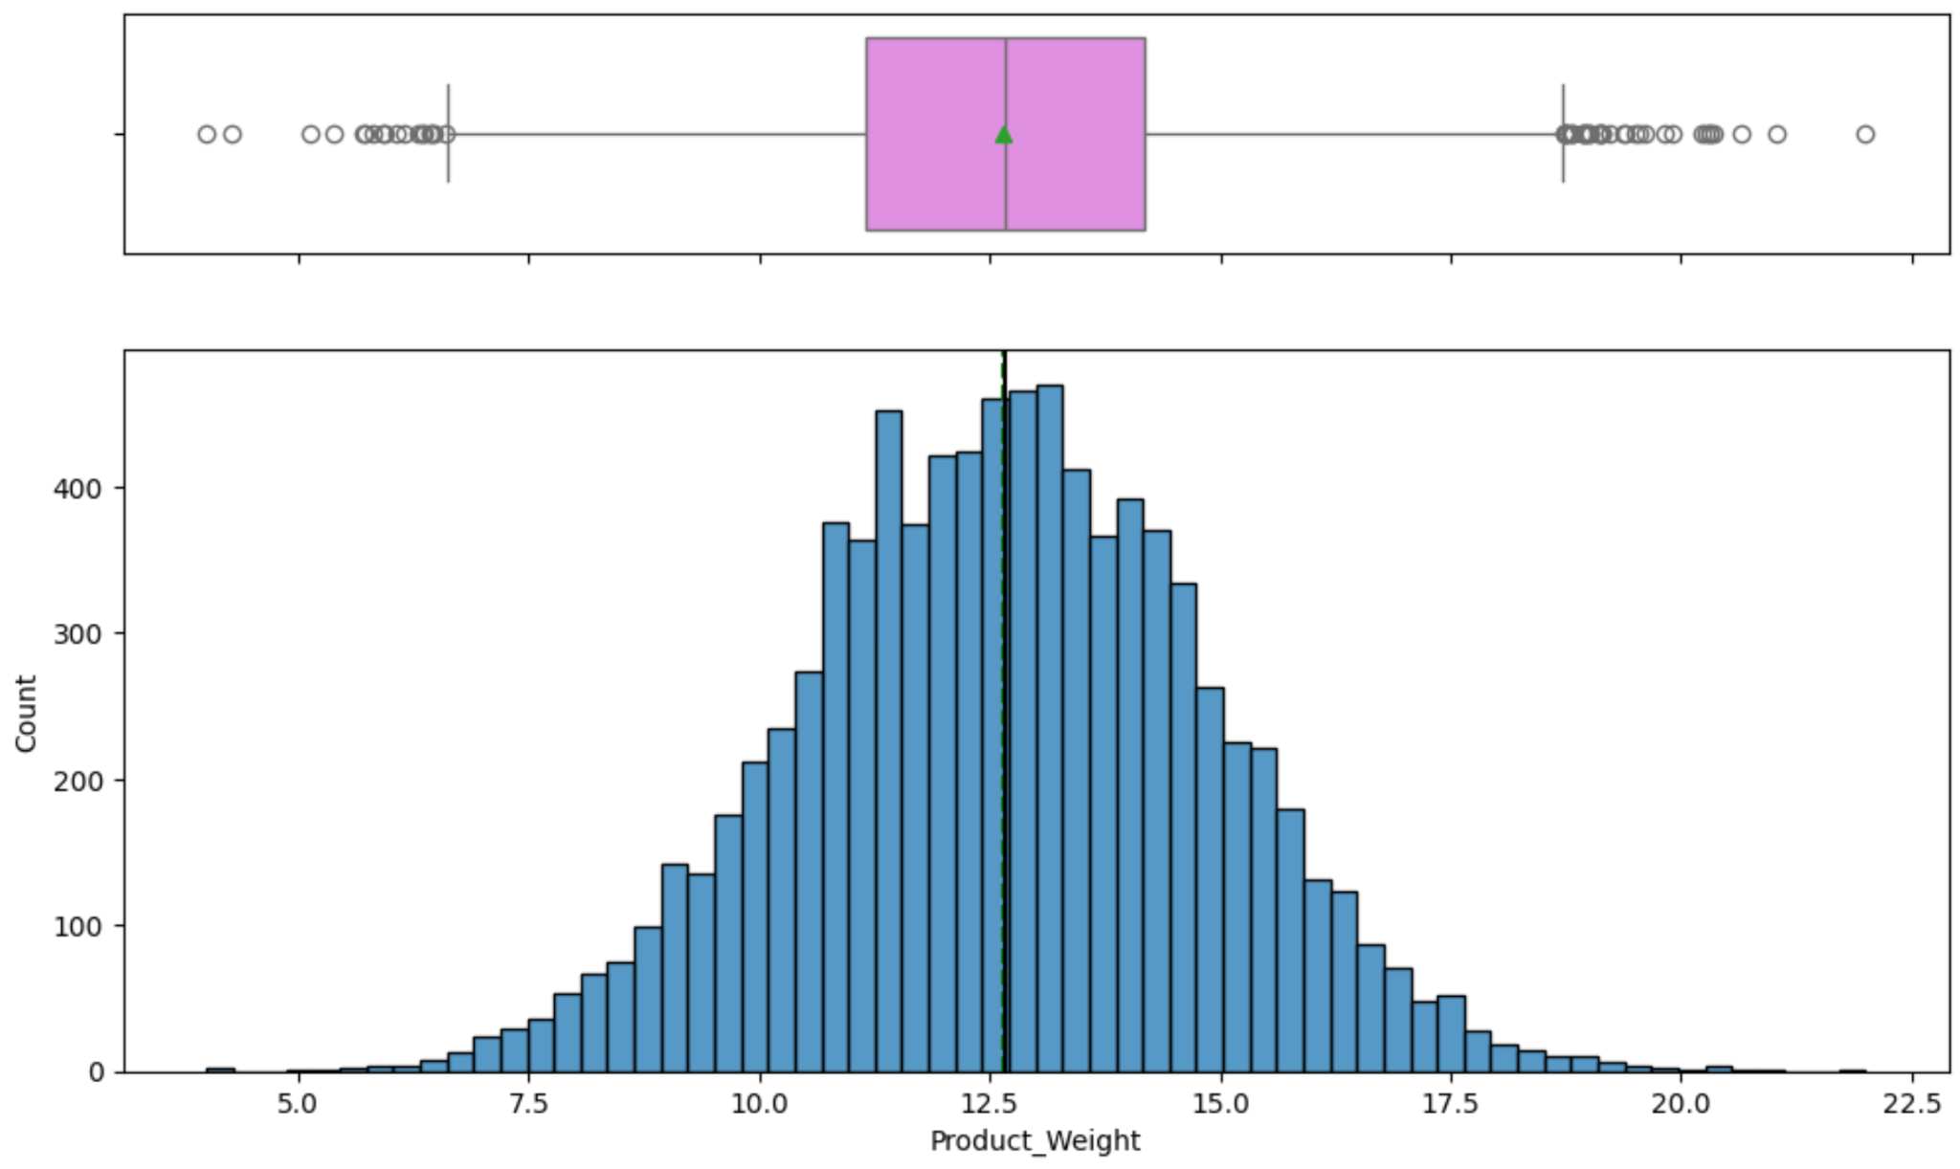
EDA Results Product Weight
Several points lie outside the whiskers—likely below 5 and above 20—indicating extreme product weights that deviate from the norm.
Product weights range from 2.5 to 22.5, consistent with the box plot.
Highest bar is near the median, with a count close to 450.
Minimal skew; distribution appears symmetric.
Link to Appendix slide on data background check

Slide 14
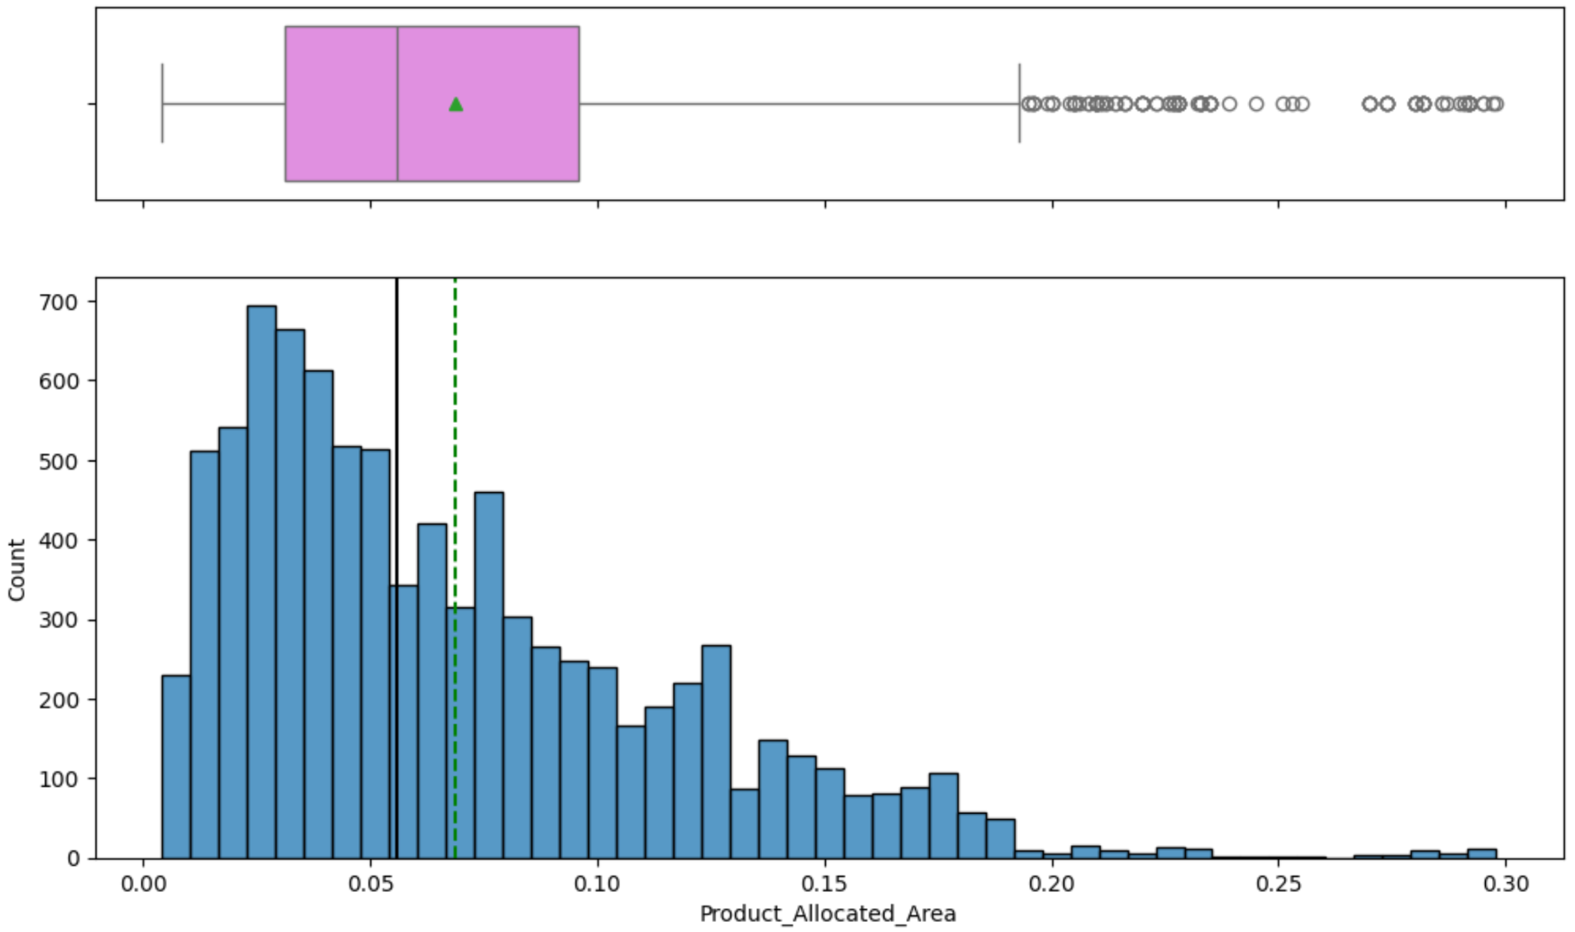
EDA Results Product Allocated Area
Outliers are present beyond the whiskers, indicating products with unusually high or low allocated area.
Bars are blue, and the distribution is heavily right-skewed
The right-skewed distribution may impact shelf optimization, promotional planning, or visual merchandising strategies.
Most products occupy a small fraction of display area, clustering below 0.10
Link to Appendix slide on data background check

Slide 15
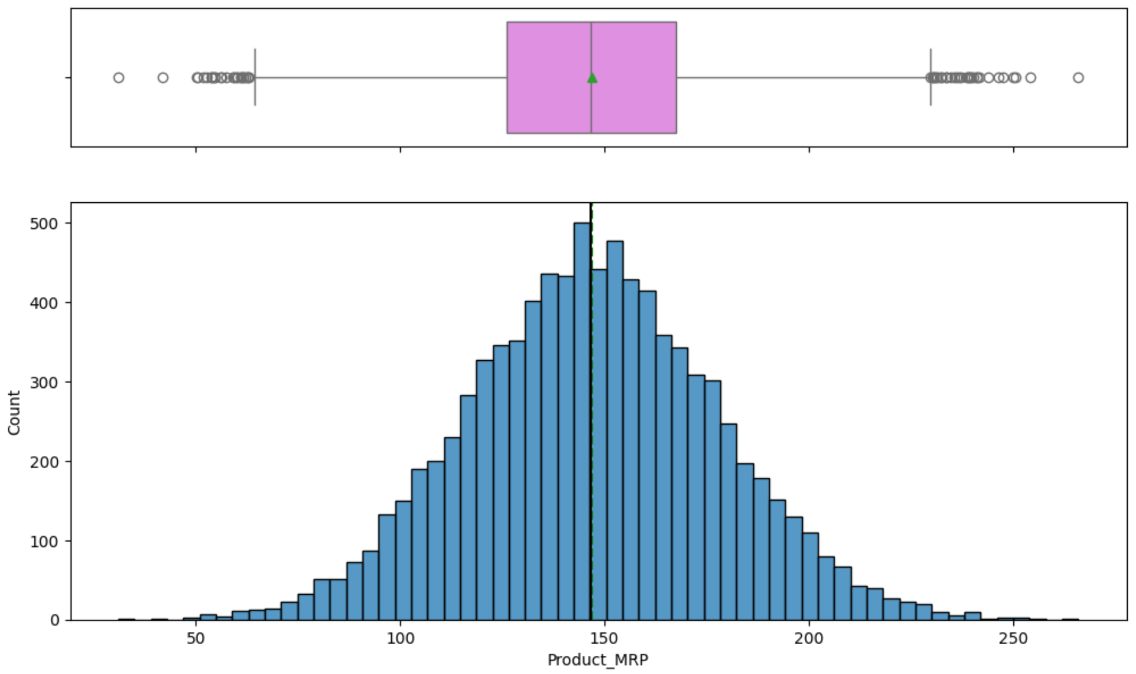
EDA Results Product MRP
Median: Shown as a horizontal line inside the box, indicating the central value of MRP.
Most products cluster around the central price range.
Both plots confirm that the median MRP is a strong representative of the dataset.
Approximately 0 to 300, covers the full price spectrum
Link to Appendix slide on data background check

Slide 16
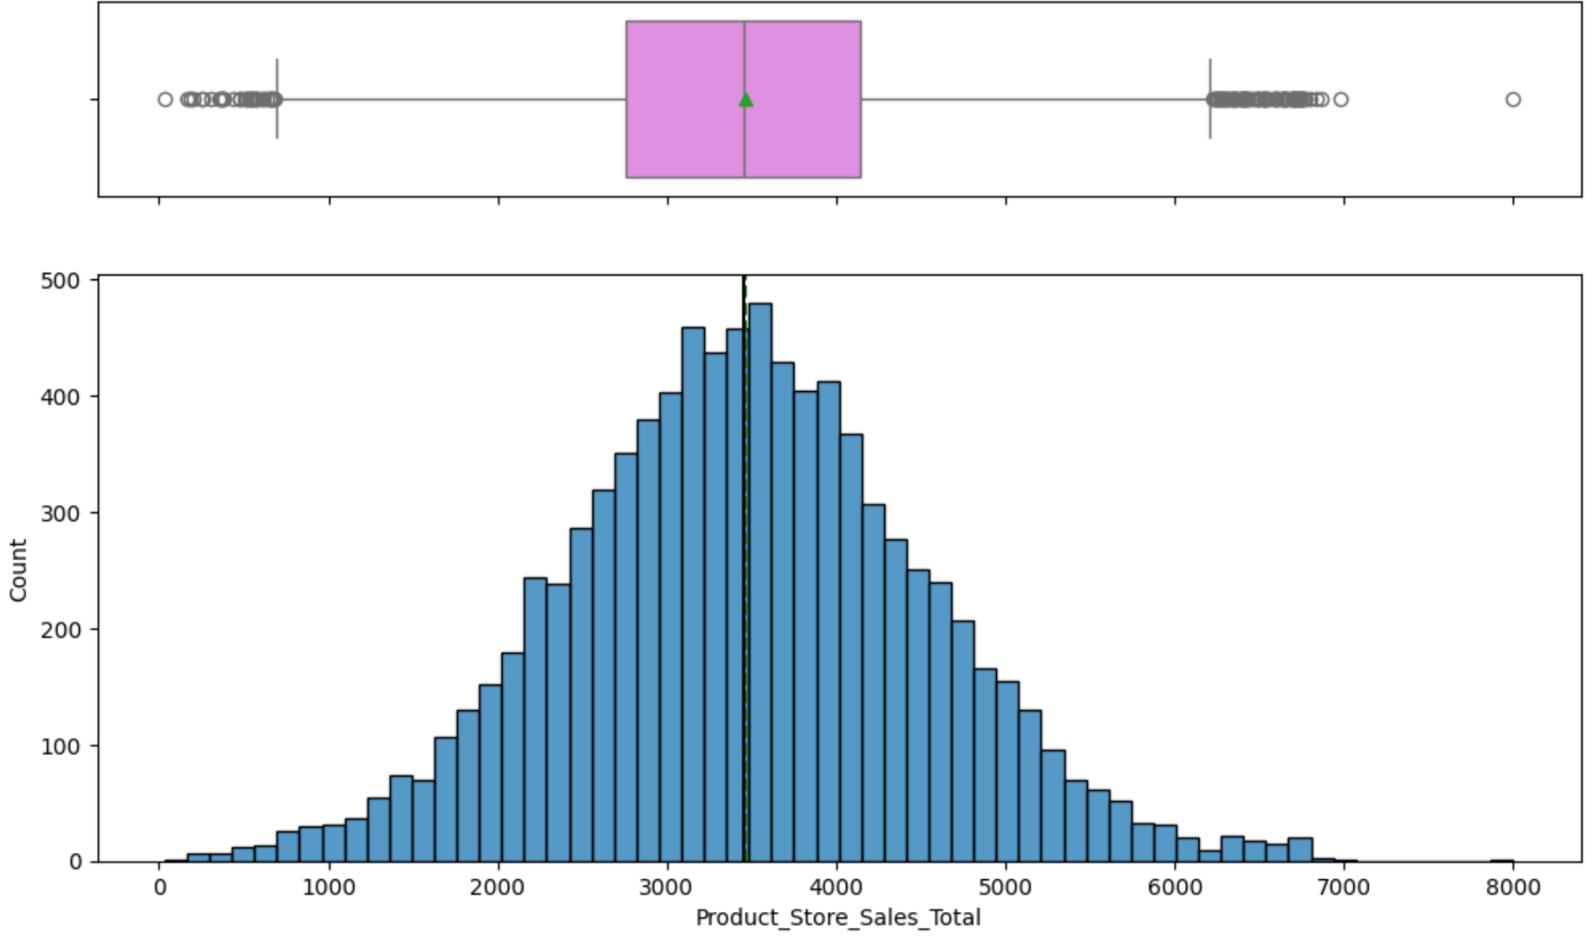
EDA Results Product Store Sales Total
Typical sales vary meaningfully around the median
Multiple outliers mostly on the high end → indicates heavy tail or rare high-sale events.
Sales totals span from 0 to ~8,000
Support starts near zero (sales can’t be negative). This natural floor can compress lower-end variance and inflate MAPE for near-zero cases.
Link to Appendix slide on data background check

Slide 17
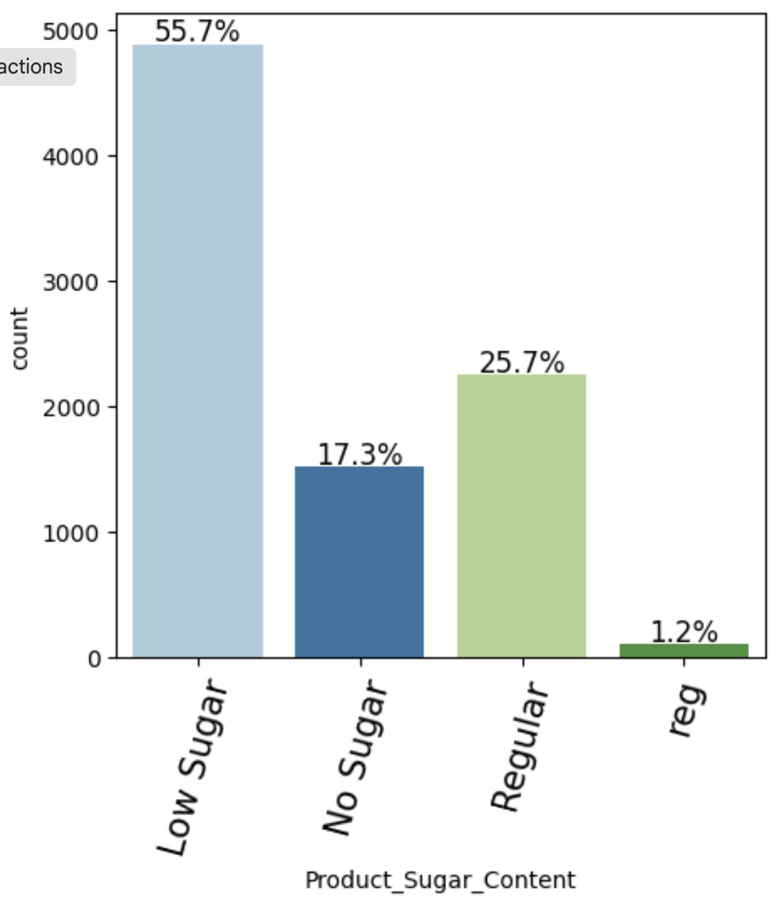
EDA Results Product Sugar Content
Low Sugar" (55.7%)
Largest segment — over half the products fall here.
Baseline offerings or reformulated products targeting health-conscious consumers
No Sugar" (17.3%)
Meaningful minority — likely includes diet-specific, diabetic-friendly, or zero-calorie items.
Regular" (25.7%)
Second-largest group — standard sugar levels.
Reg (1.2%)
Duplicate/ambiguous label — possibly a typo or inconsistent data entry
Link to Appendix slide on data background check

Slide 18
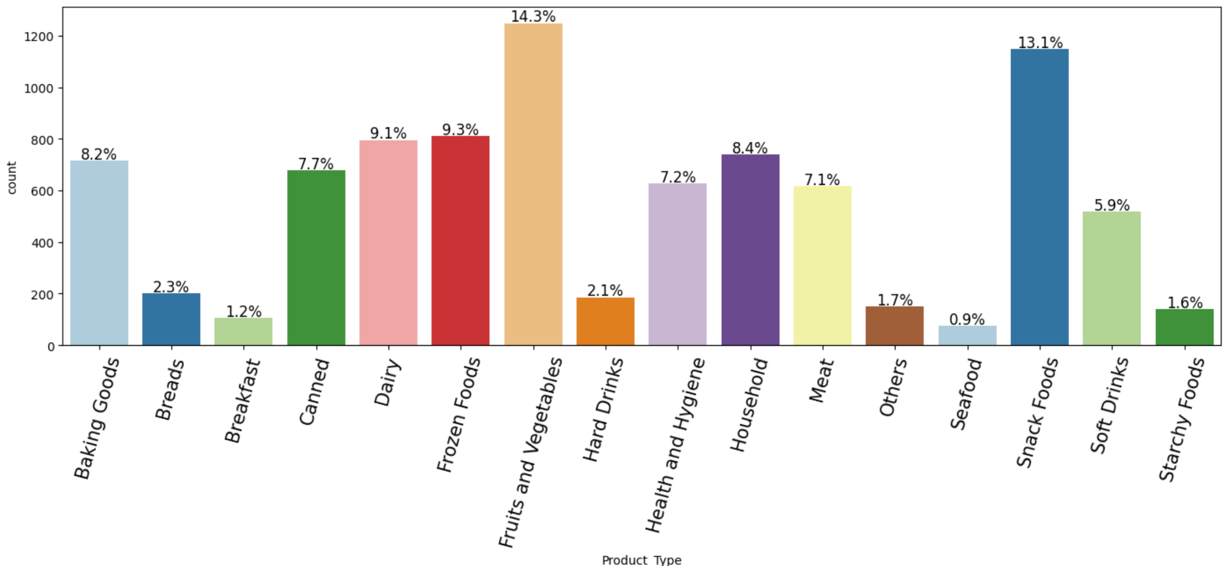
EDA Results Product Type
Category granularity - some categories may overlap (e.g., “Breakfast” vs “Breads” vs “Snack Foods”)
Skewed distribution may require class balancing
Link to Appendix slide on data background check

Slide 19
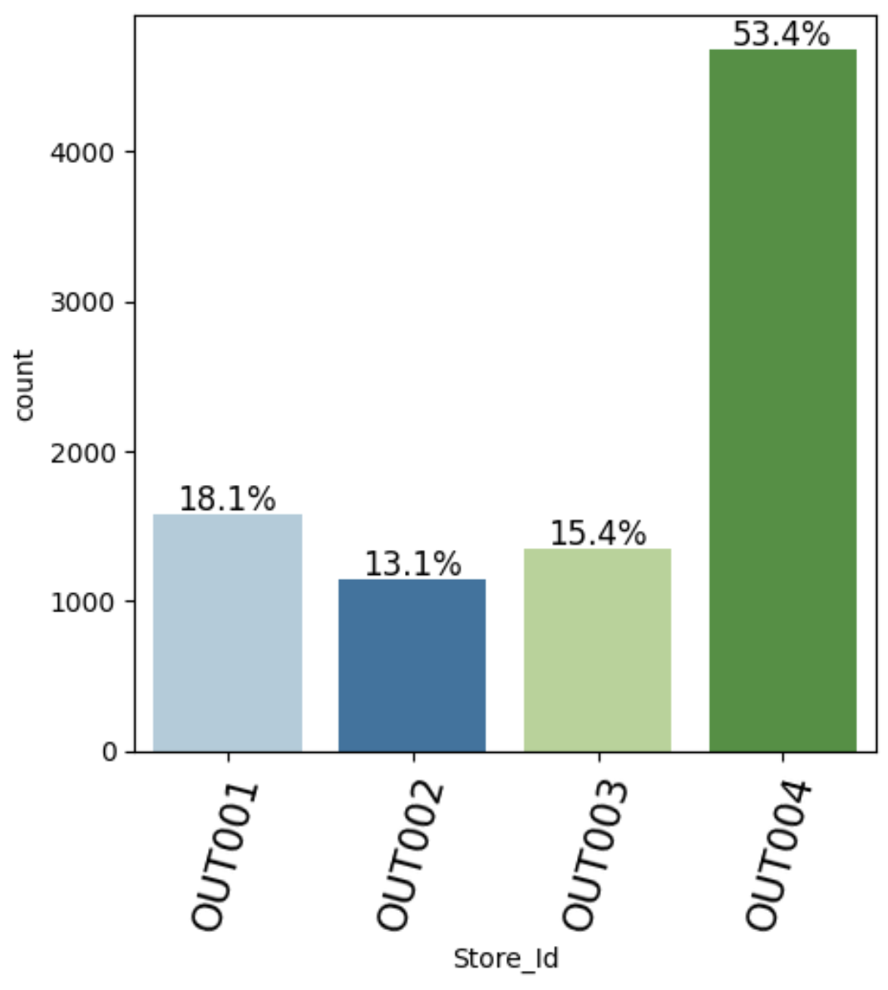
EDA Results Store Id
OUT004 heavily dominates the item count. This imbalance can influence predictive models if not handled carefully.
OUT001 - Second-highest count — substantial inventory, possibly a regional hub.
OUT003 - Moderate inventory — may reflect a mid-sized outlet.
OUT002 -Smallest volume — could be a niche or specialized store.
Link to Appendix slide on data background check

Slide 20
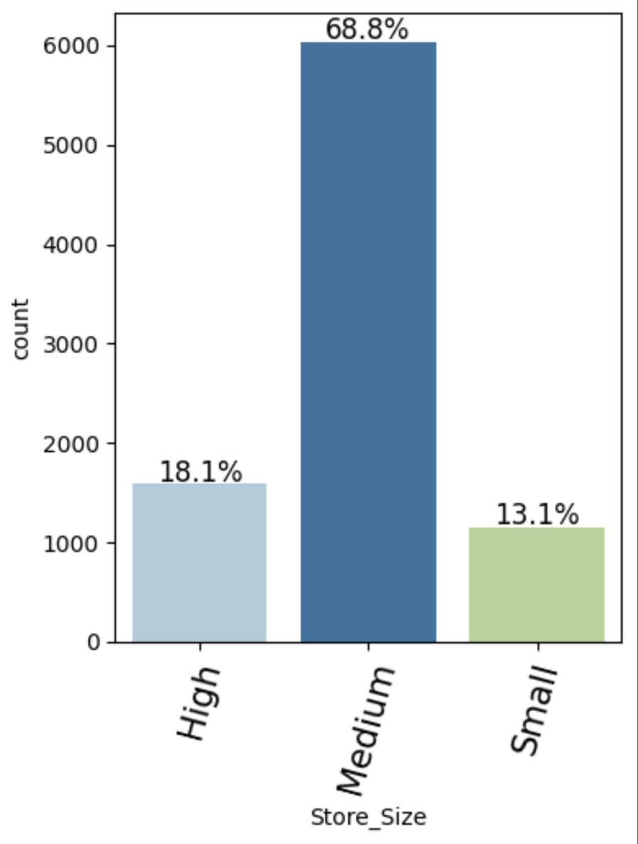
EDA Results Store Size
Medium 68.8% Dominant category represents standard retail footprints
High 18.1% Less common — possibly flagship stores or regional hubs
Small 13.1% Niche or low-volume stores — may serve targeted/localized markets
Link to Appendix slide on data background check

Slide 21
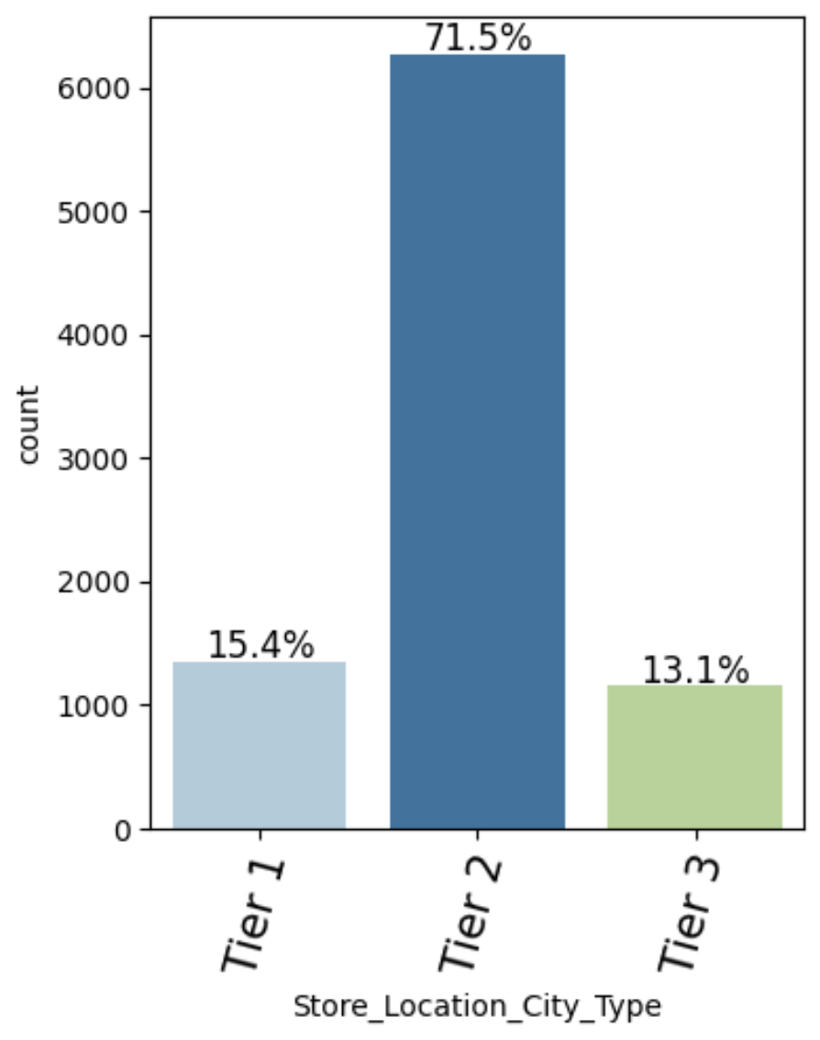
EDA Results Store Location City Type
Tier 2 has a Dominant share 71.5 % — most stores are located in mid-sized urban markets
Tier 1 (15.4% or 1,300) Stores are located in Major metros — less coverage, possibly fewer but larger-format stores
Tier 3 13.1% - Small towns or semi-urban regions — limited presence, may affect product demand
Link to Appendix slide on data background check

Slide 22
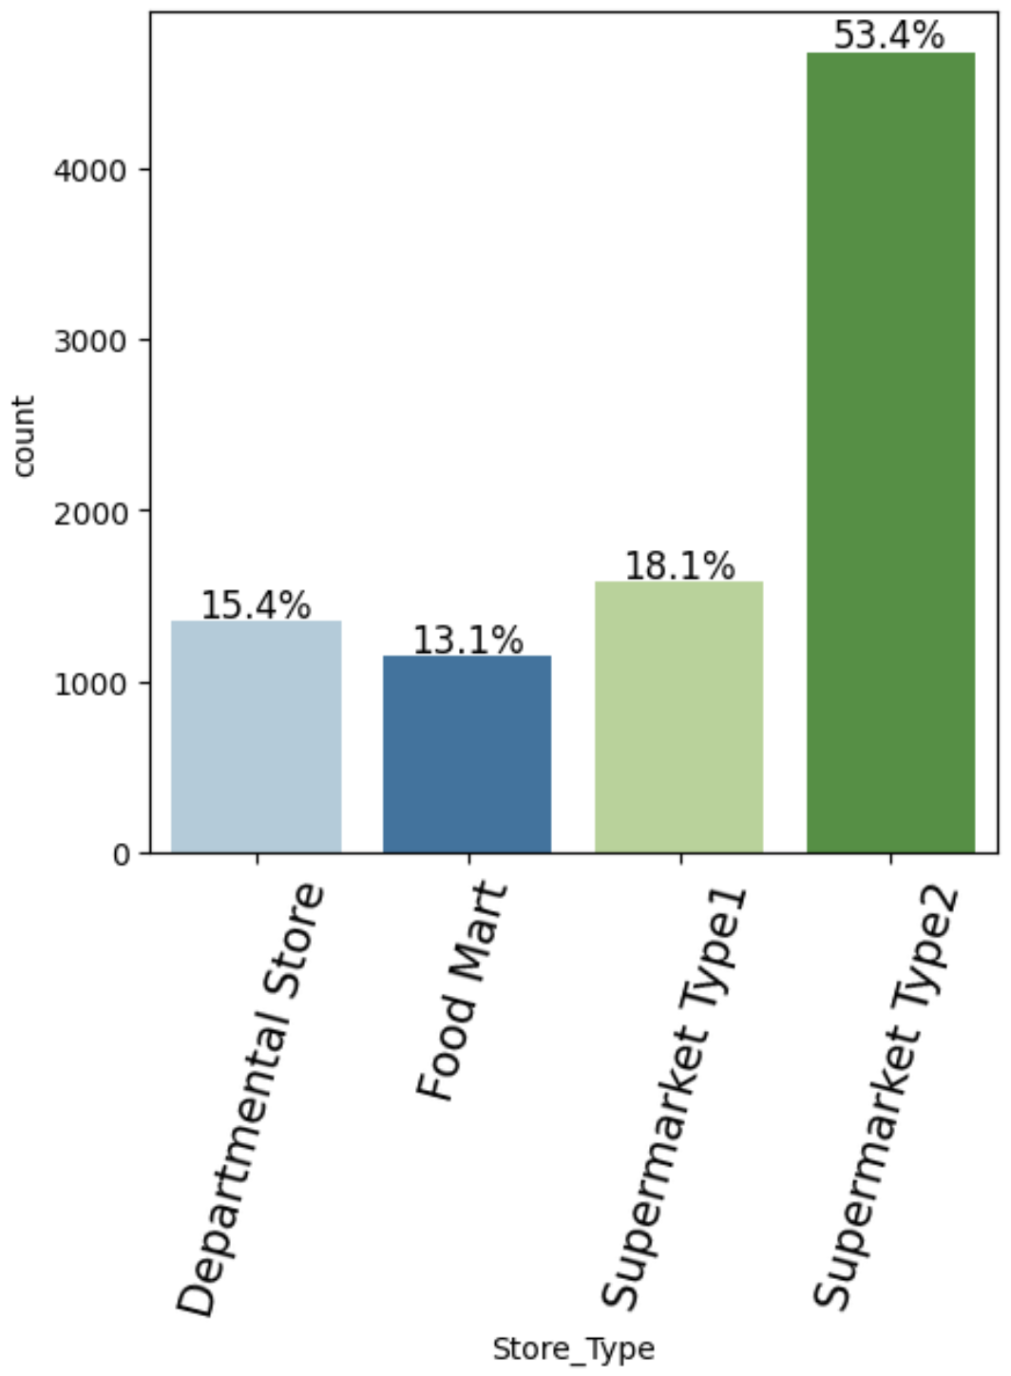
EDA Results Store Type
Supermarket Type2 - 4,000+ Store are the core driver of product sales and revenue. Dominant Format
Supermarket Type 1 - Secondary format — potentially similar layout, but fewer locations
Departmental Store - Diversified offerings — may carry broad product categories. 15.4%
Food Mart - Convenience-centric — lower inventory, high footfall rotation possible
Link to Appendix slide on data background check

Slide 23
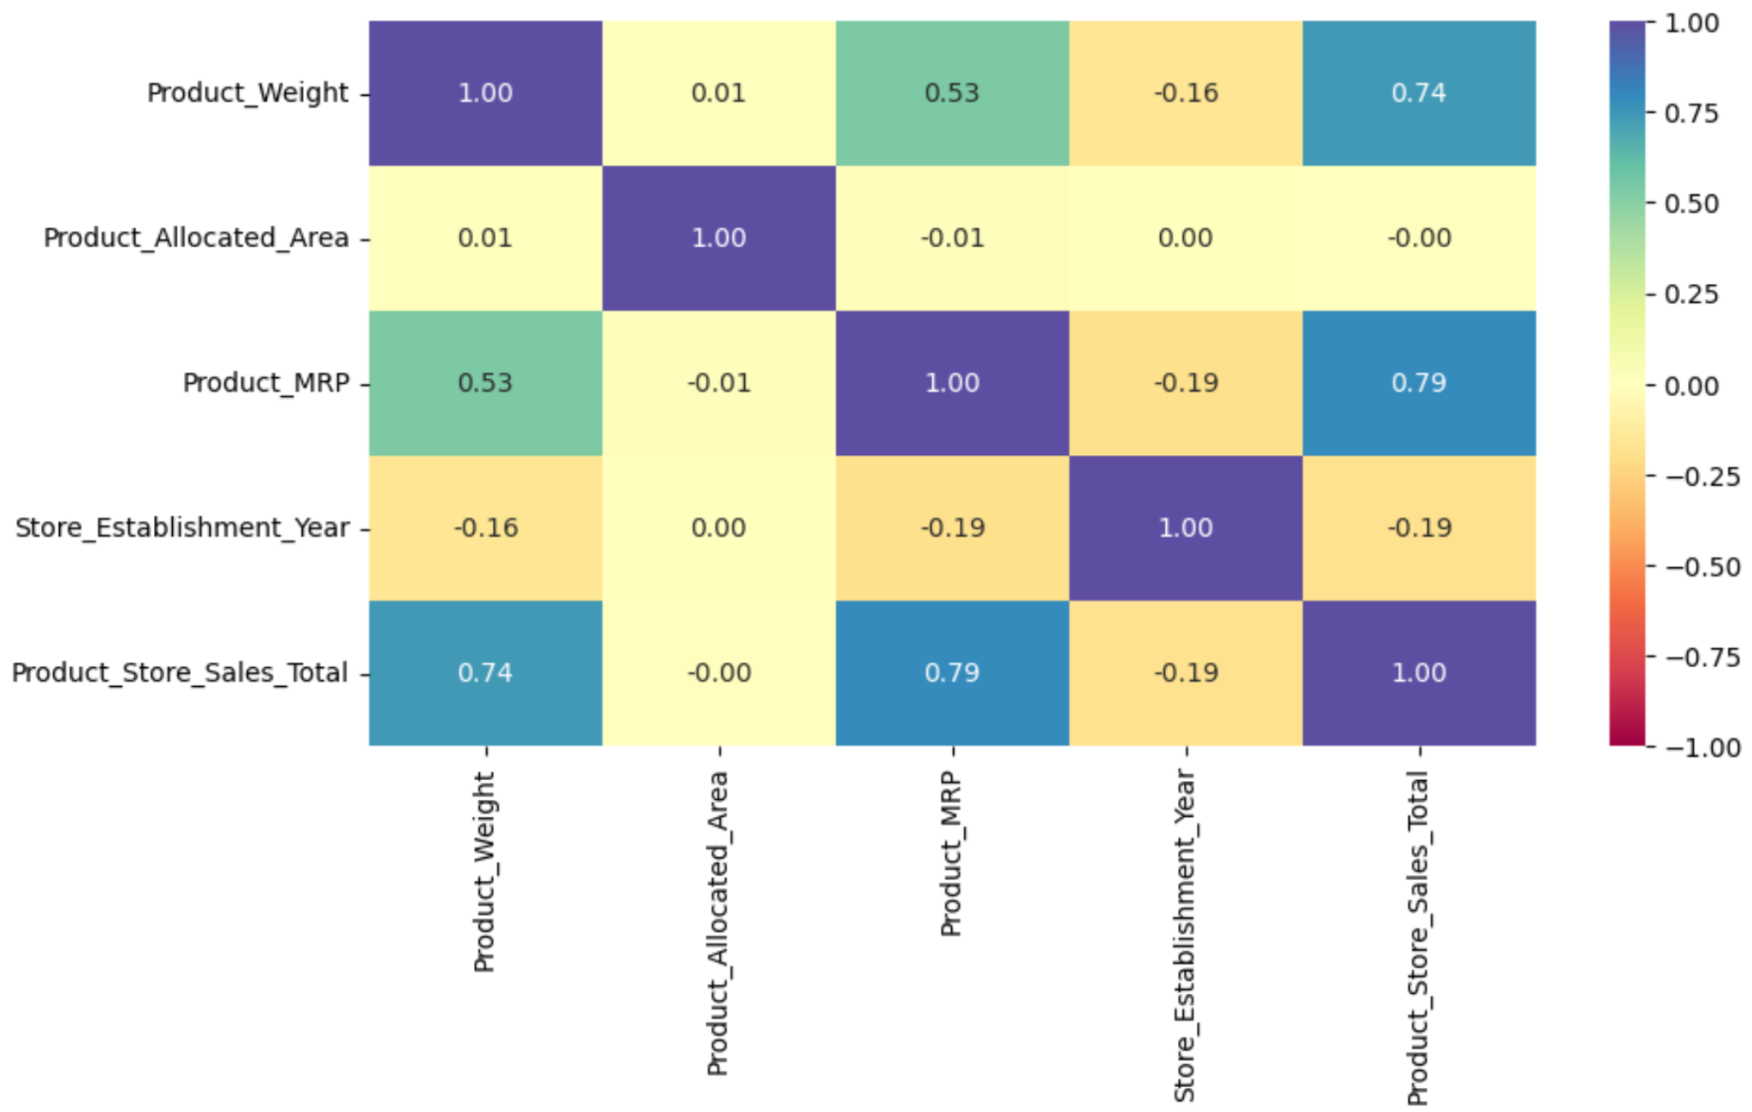
EDA Results Correlation Matrix
The moderate correlation between Weight and MRP (0.53) signals overlapping information (bigger packs → higher price)
Older stores tend to have higher sales
Product MRP Strong linear driver of sales total
Link to Appendix slide on data background check

Slide 24
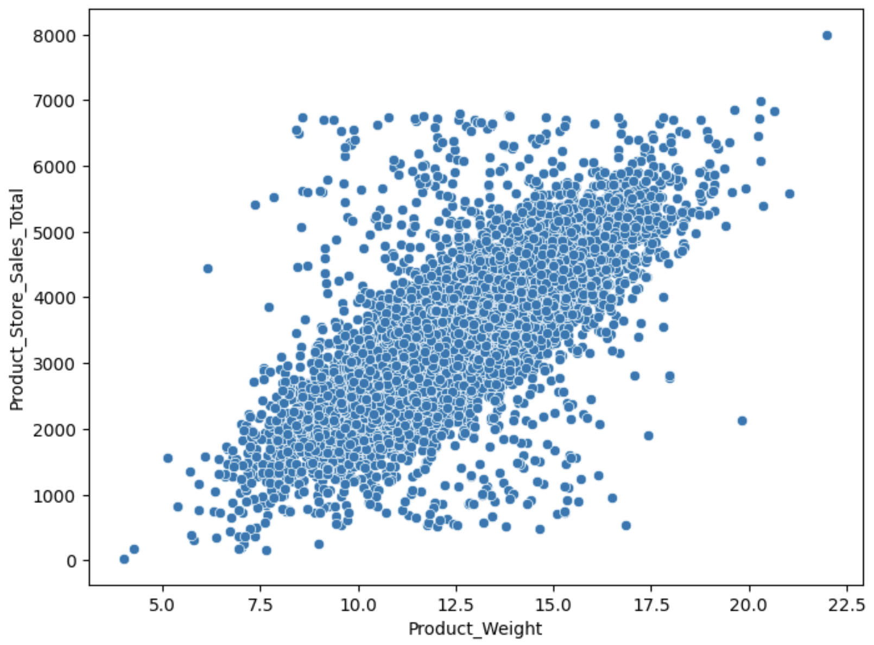
EDA Results Product Weight vs Product Store Sales Total
Trend - Clear upward trajectory — sales increase as product weight increases
Correlation - Strong positive — supported by earlier correlation coefficient of 0.74
Outliers - A few higher-weight items yield exceptionally high sales (~8000 range)
Linearity - Relationship appears broadly linear, but some tapering at upper weight range
Link to Appendix slide on data background check

Slide 25
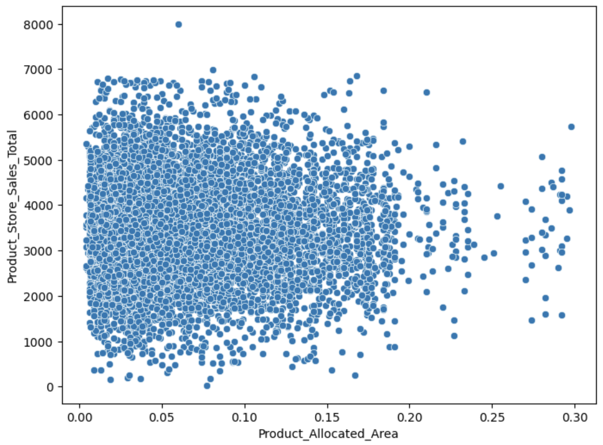
EDA Results Product Allocated Area vs Product Store Sales Total
Clustered Range Most data points fall within area values of 0.00 to 0.20 and sales of 0–6000
Trend No strong visible pattern or upward curve — suggests weak or no linear correlation
Density High concentration of points in lower area ranges — bulk of products have small footprints
Outliers A few products with slightly larger areas, but not significantly higher sales
Link to Appendix slide on data background check

Slide 26
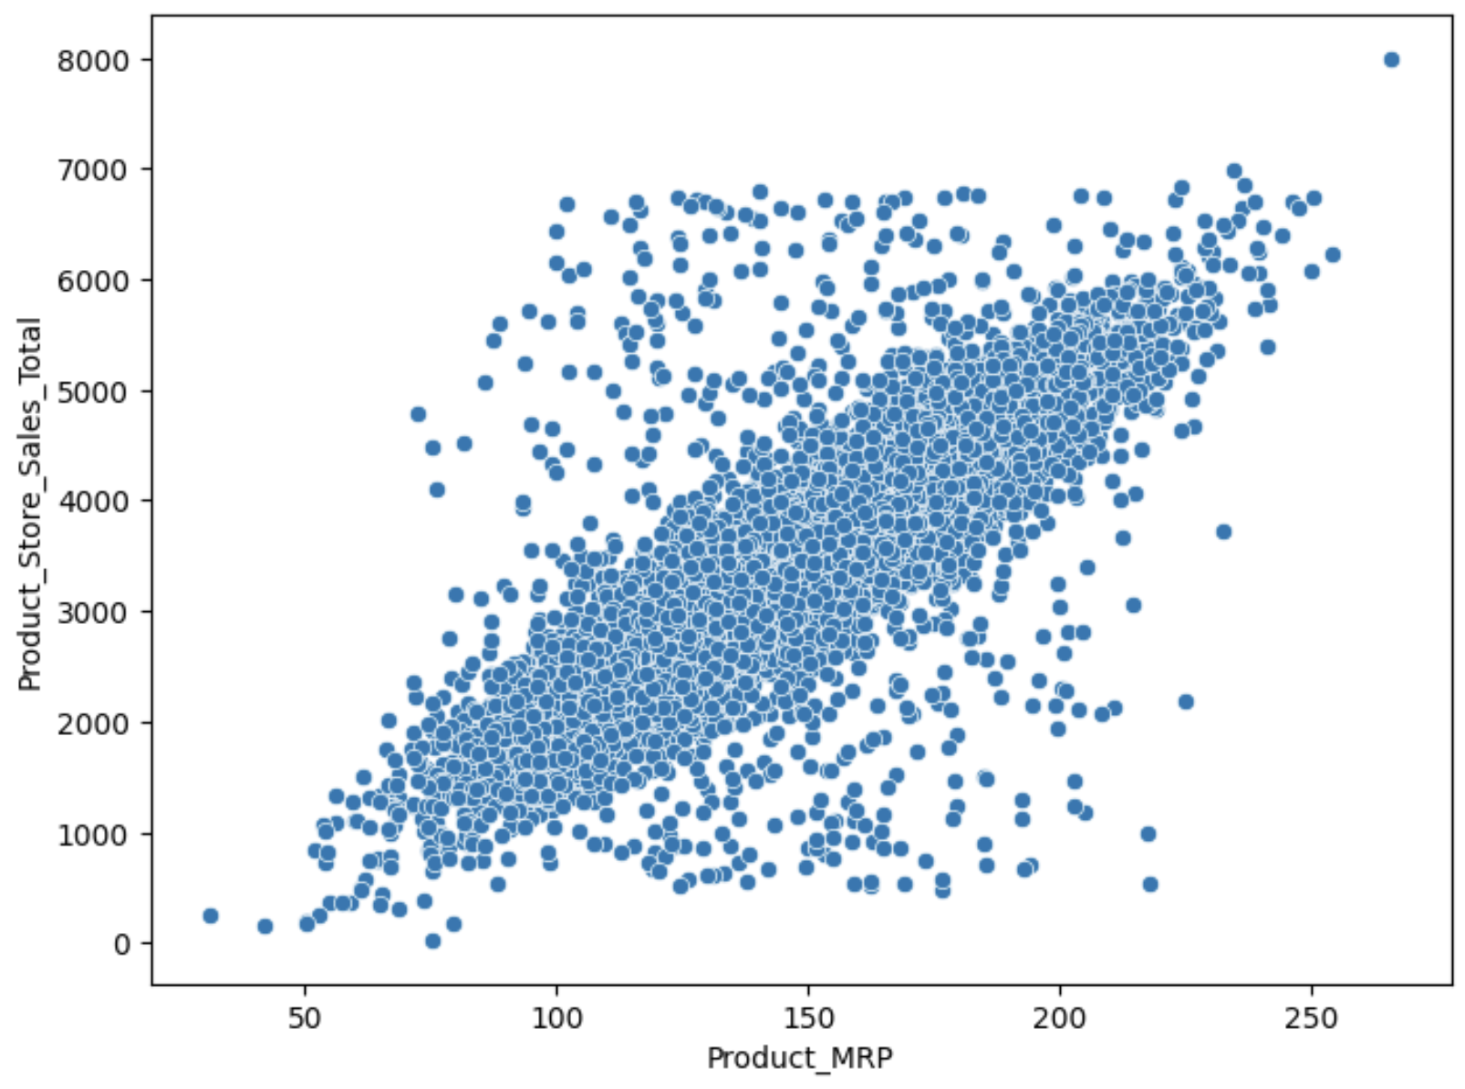
EDA Results Product MRP vs Product Store Sales Total
Clear positive relationship
As MRP rises, total sales increase—consistent with the idea that higher-priced (often larger/premium) items generate more revenue per transaction.
Expect a strong correlation (matrix showed ~0.79), meaning MRP is a dominant driver of the target.
Confounding with pack size
MRP and Product_Weight tend to move together (bigger packs → higher price).
Link to Appendix slide on data background check

Slide 27
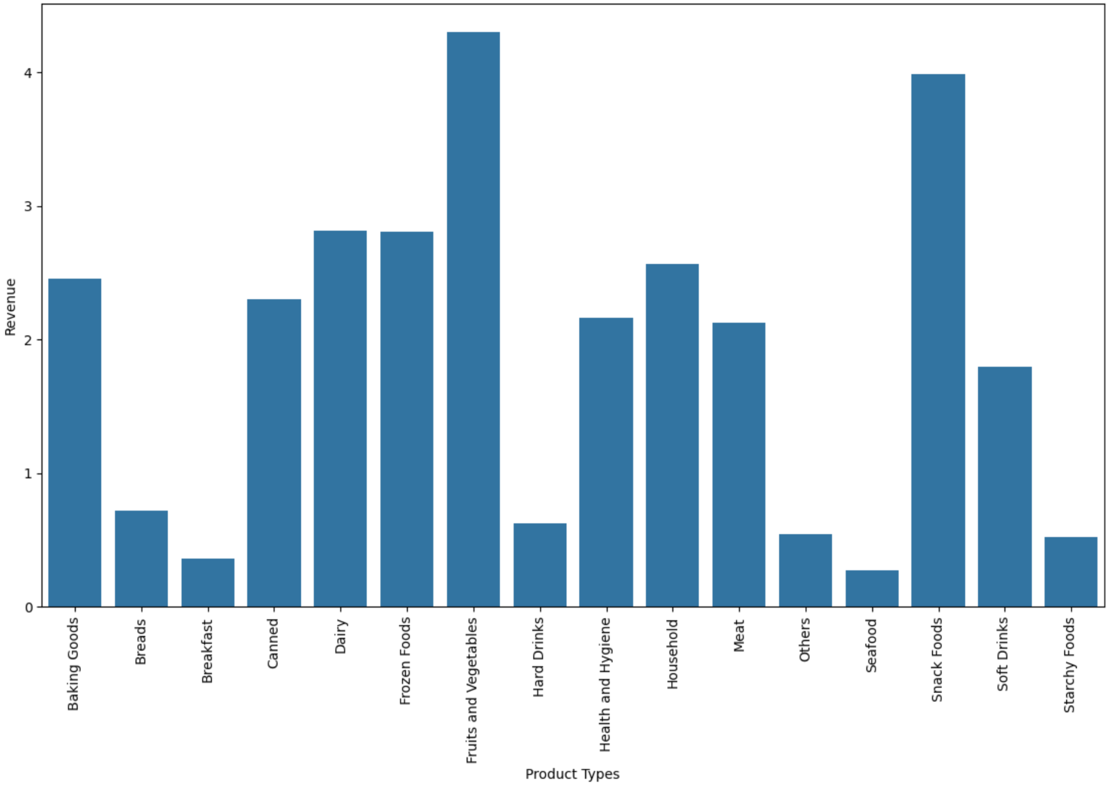
EDA Results Product Type vs Revenue
Top earners
Snack Foods lead revenue generation—likely high-volume sales with strong margin and frequent purchase behavior.
Fruits and Vegetables follow closely—suggesting consistent demand, possibly influenced by perishability and health-conscious buyers.
Link to Appendix slide on data background check

Slide 28
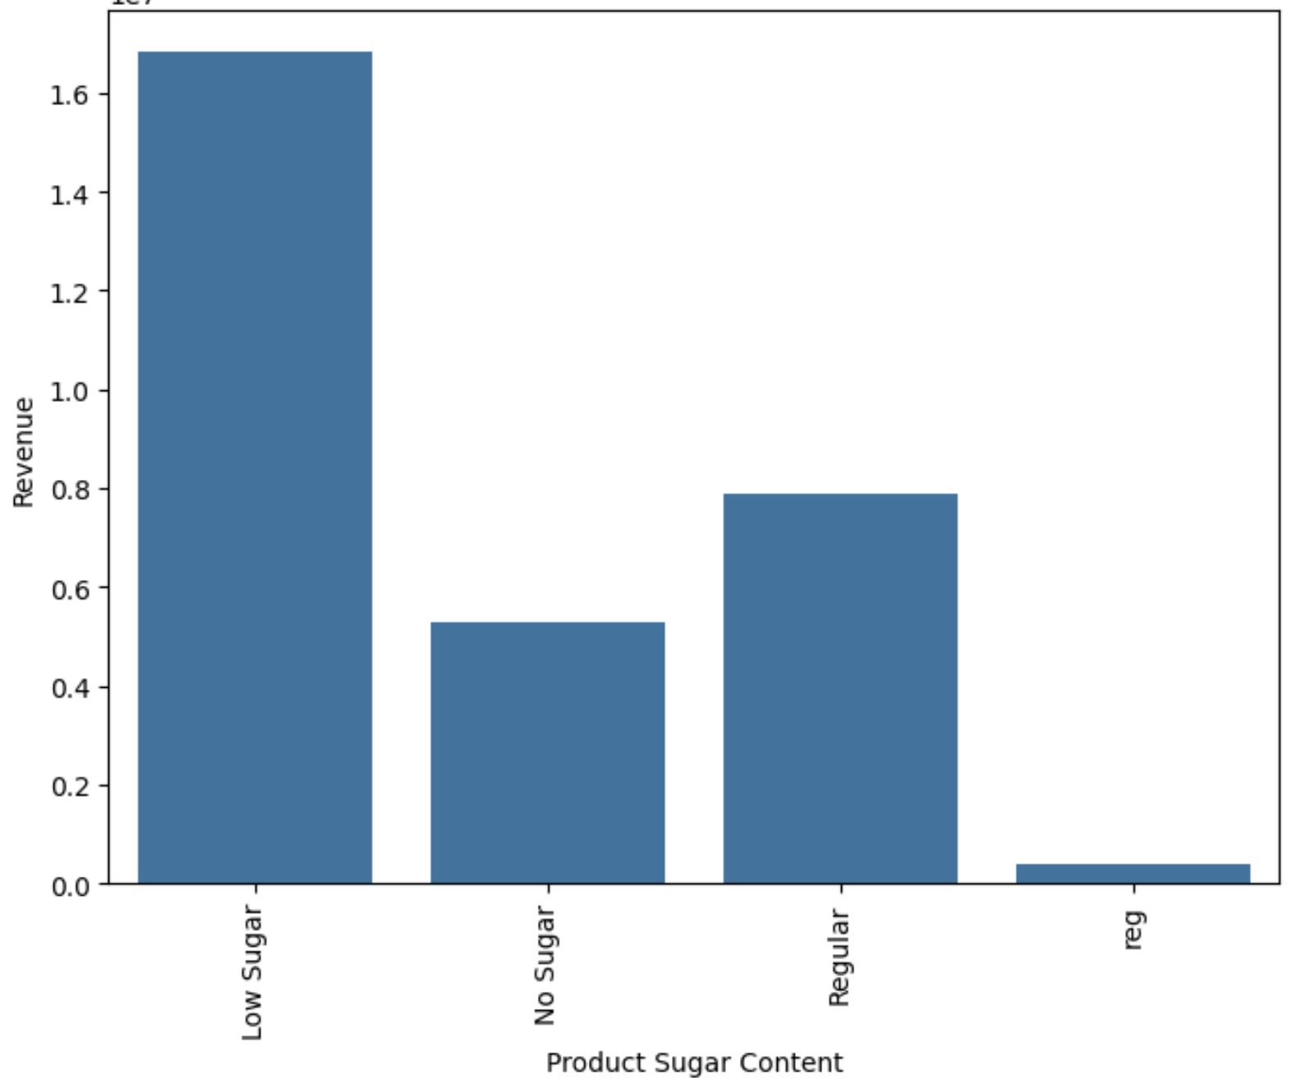
EDA Results Product Sugar Content Revenue
Top Performer: Low Sugar products show the highest revenue, suggesting strong market demand for moderately sweet alternatives—potentially favored by health-conscious consumers who aren’t ready to go sugar-free.
Y-axis (Revenue): Ranges from 0.0 to 1.8.
Underperformance of 'No Sugar': Indicates that sugar-free products may not be driving as much consumer spend—this could reflect taste preferences, niche appeal, or weaker product variety.
Link to Appendix slide on data background check

Slide 29
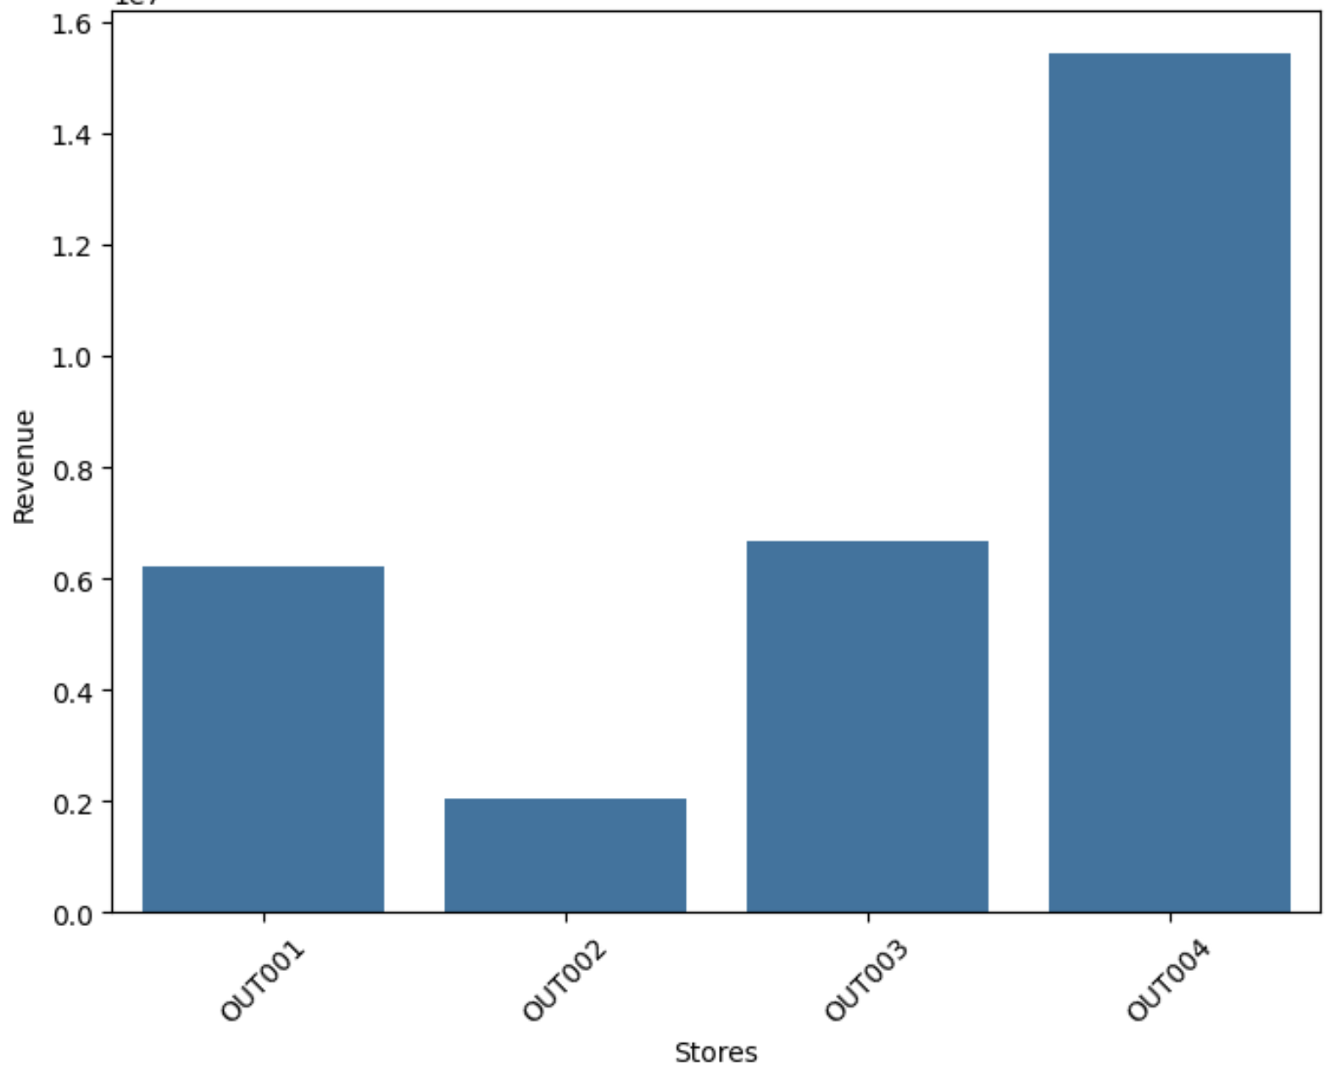
EDA Results Stores Revenue
Out004 - Market leader—consistently outperforming peers Revenue Highest (~1.6 units)
Out001 - Strong performer, close competitor to Out004
OUT003 Moderate (~1.1 units) Mid-tier—potential for targeted growth
OUT002 Lowest (~0.9 units) Underperformer—needs evaluation or optimization
Link to Appendix slide on data background check

Slide 30
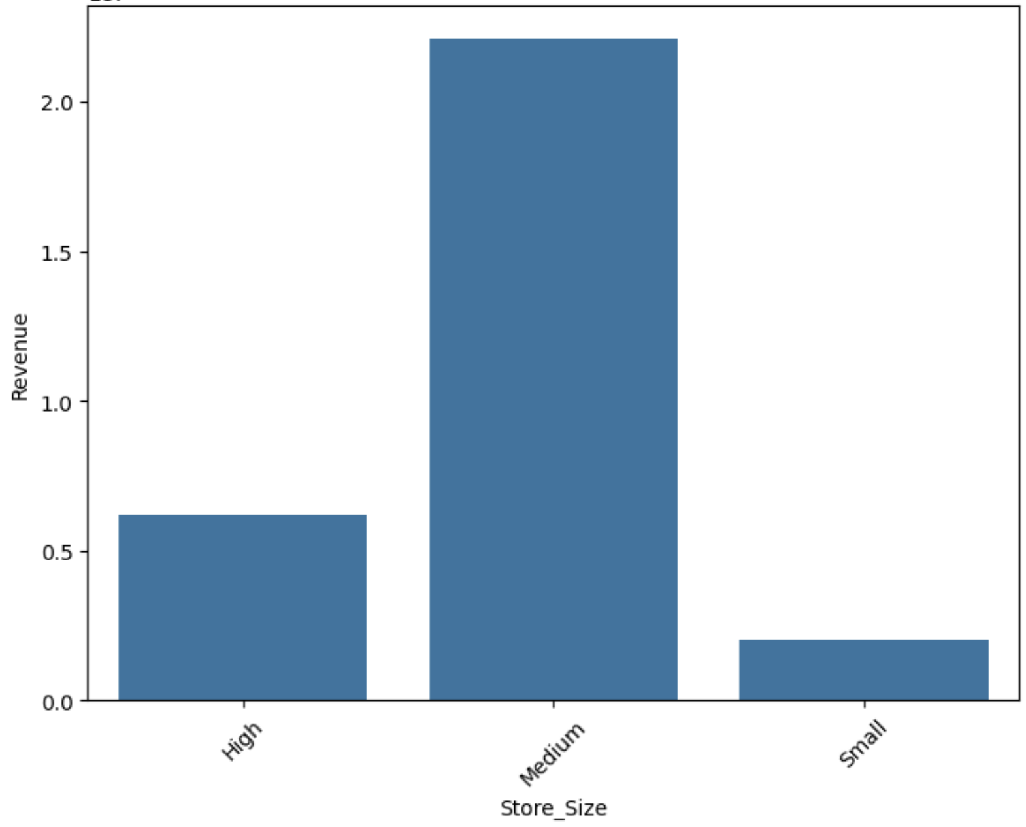
EDA Results Store Size Revenue
Medium-sized stores lead revenue, followed by high-sized, then small. This suggests a possible sweet spot where assortment breadth, staffing, and operating costs are balanced.
Beware simple rank-order conclusions. Total revenue can be confounded by location quality, store age, product mix, and traffic. Medium’s lead may reflect those factors rather than footprint alone.
Pattern hints at an inverted-U: beyond a certain size, additional square footage may deliver diminishing returns in sales per unit space.
Link to Appendix slide on data background check

Slide 31
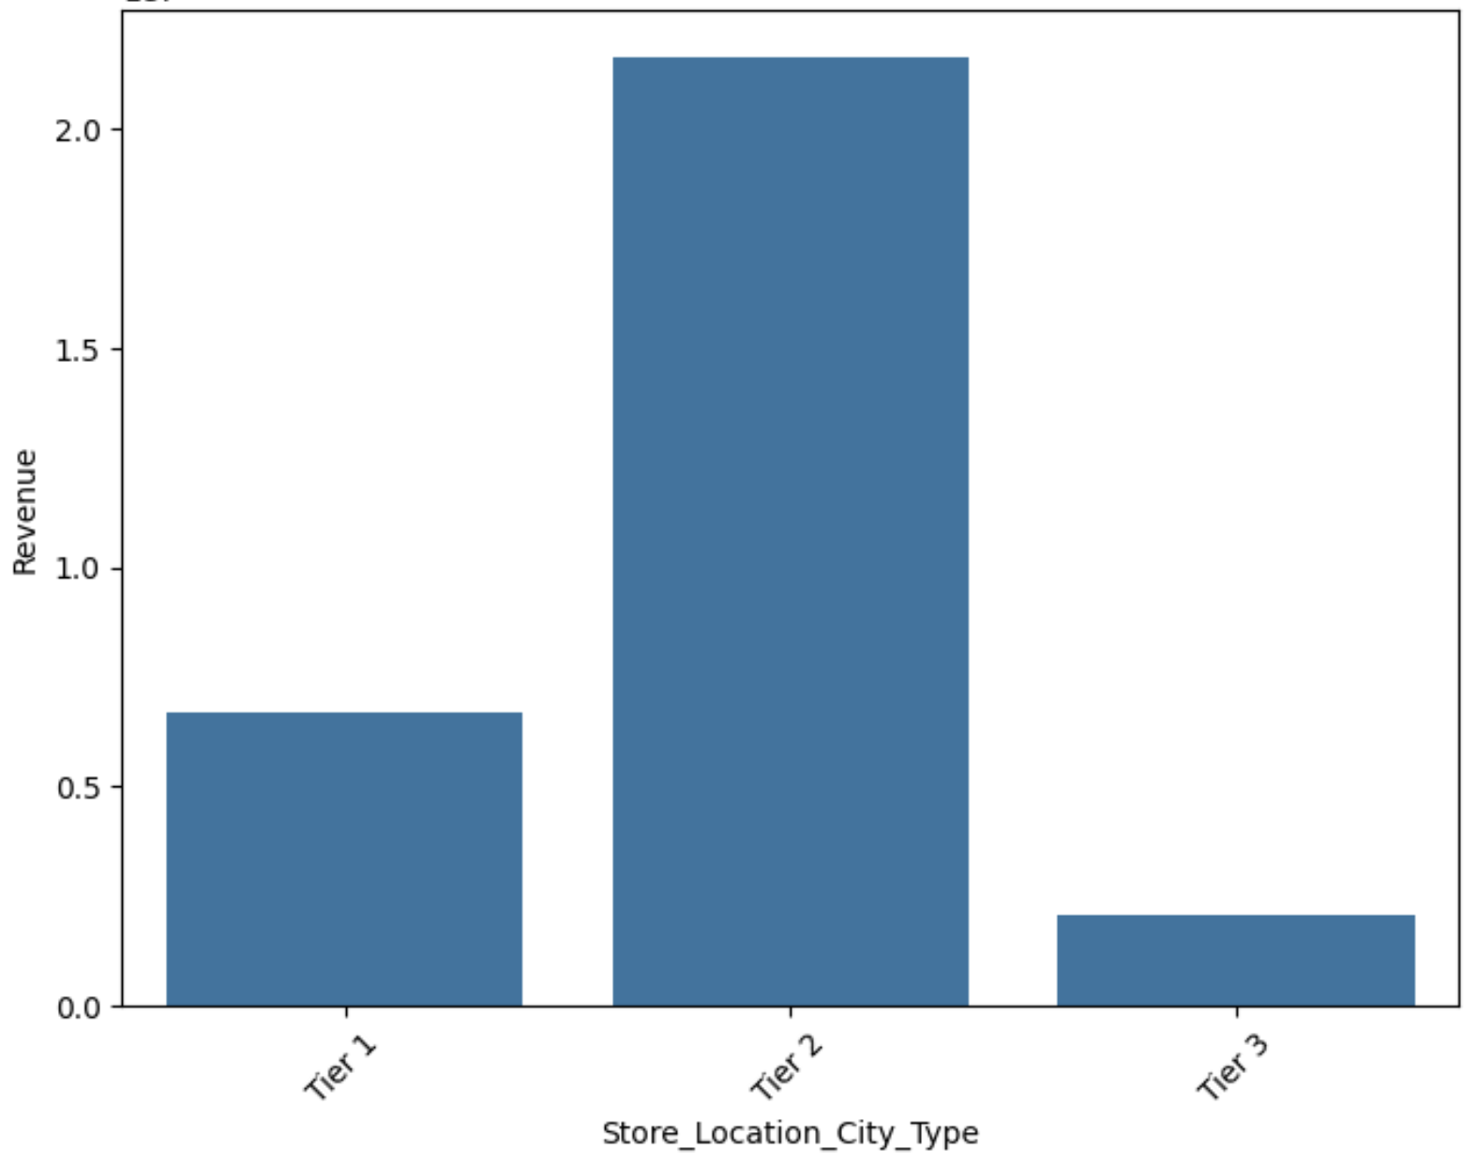
EDA Results Store Location Type Revenue
Tier 2 cities top revenue: These locations outperform both Tier 1 and Tier 3, suggesting an optimal balance of population density, affordability, and customer demand.
Tier 1 under Tier 2: Despite premium demographics, high operating costs, intense competition, and space constraints might dilute returns.
Tier 3 lags: Lower foot traffic, smaller catchment areas, or reduced purchasing power could explain reduced revenue.
Link to Appendix slide on data background check

Slide 32
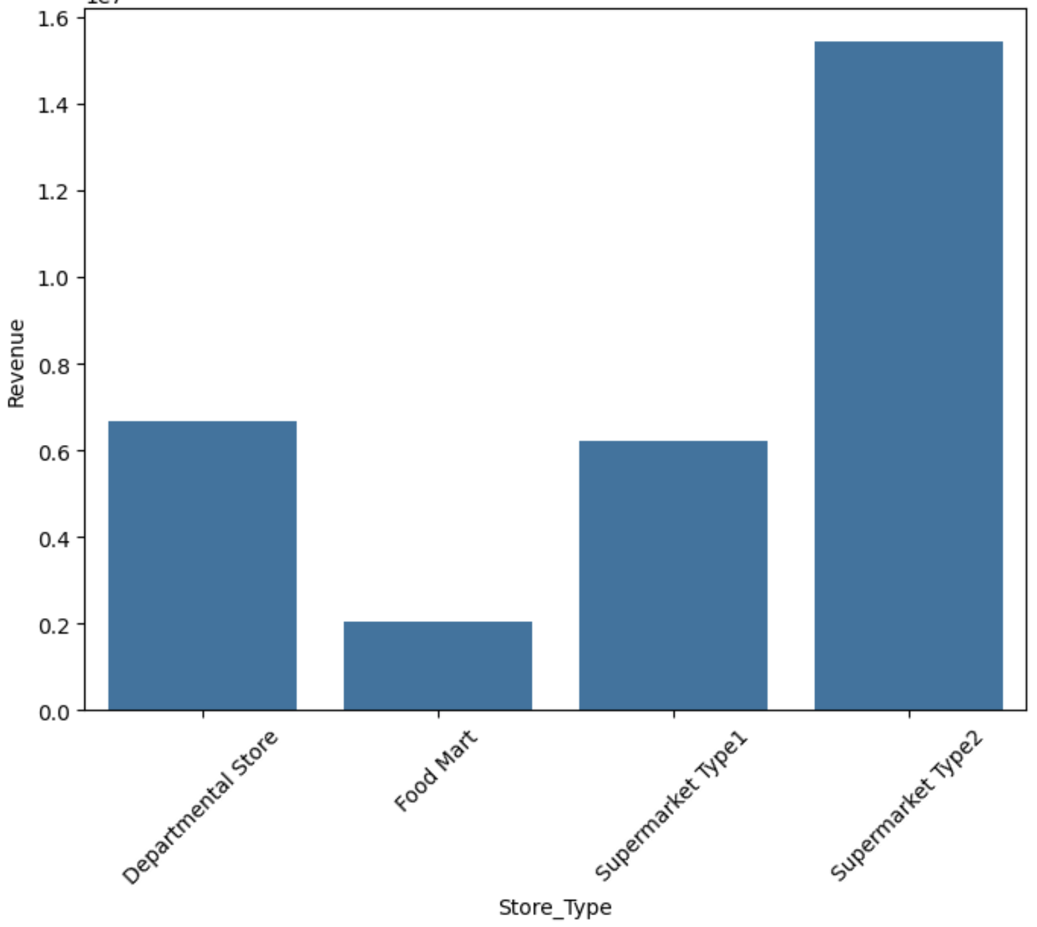
EDA Results Store Type Revenue
Supermarket Type2 leads: Highest revenue suggests strong product mix, foot traffic, and possibly larger basket sizes or store footprint.
Departmental Store performs second: May benefit from non-grocery categories or more diverse assortments, but likely with higher operating costs.
Supermarket Type1 underperforms relative to Type2: Could reflect outdated layouts, limited variety, or less favorable locations.
Food Mart struggles: Lowest revenue may stem from small format, narrower assortments, or fewer high-margin items.
Link to Appendix slide on data background check

Slide 33
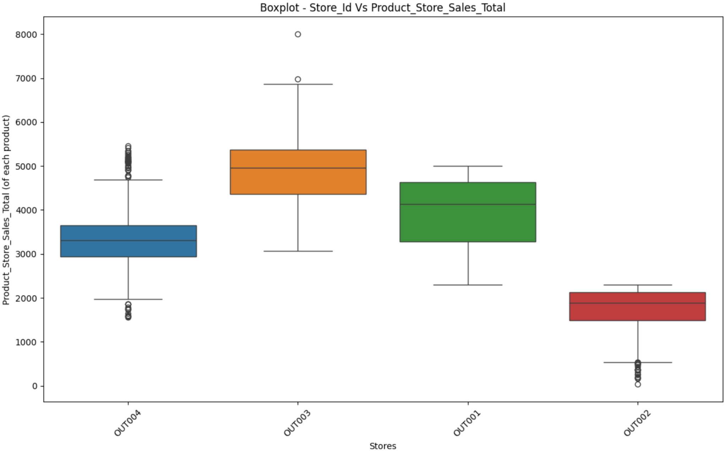
EDA Results Product Store Id vs Product Store Sales Total
OUT003 shows the highest median and a relatively broad spread, indicating consistently stronger product performance with some variability.
OUT002 has the lowest median and several low-end outliers, pointing to underperforming products and potential data/stock issues.
OUT004 Targeted optimization can lift median further
OUT001; Tune mix and inventory discipline
Link to Appendix slide on data background check

Slide 34
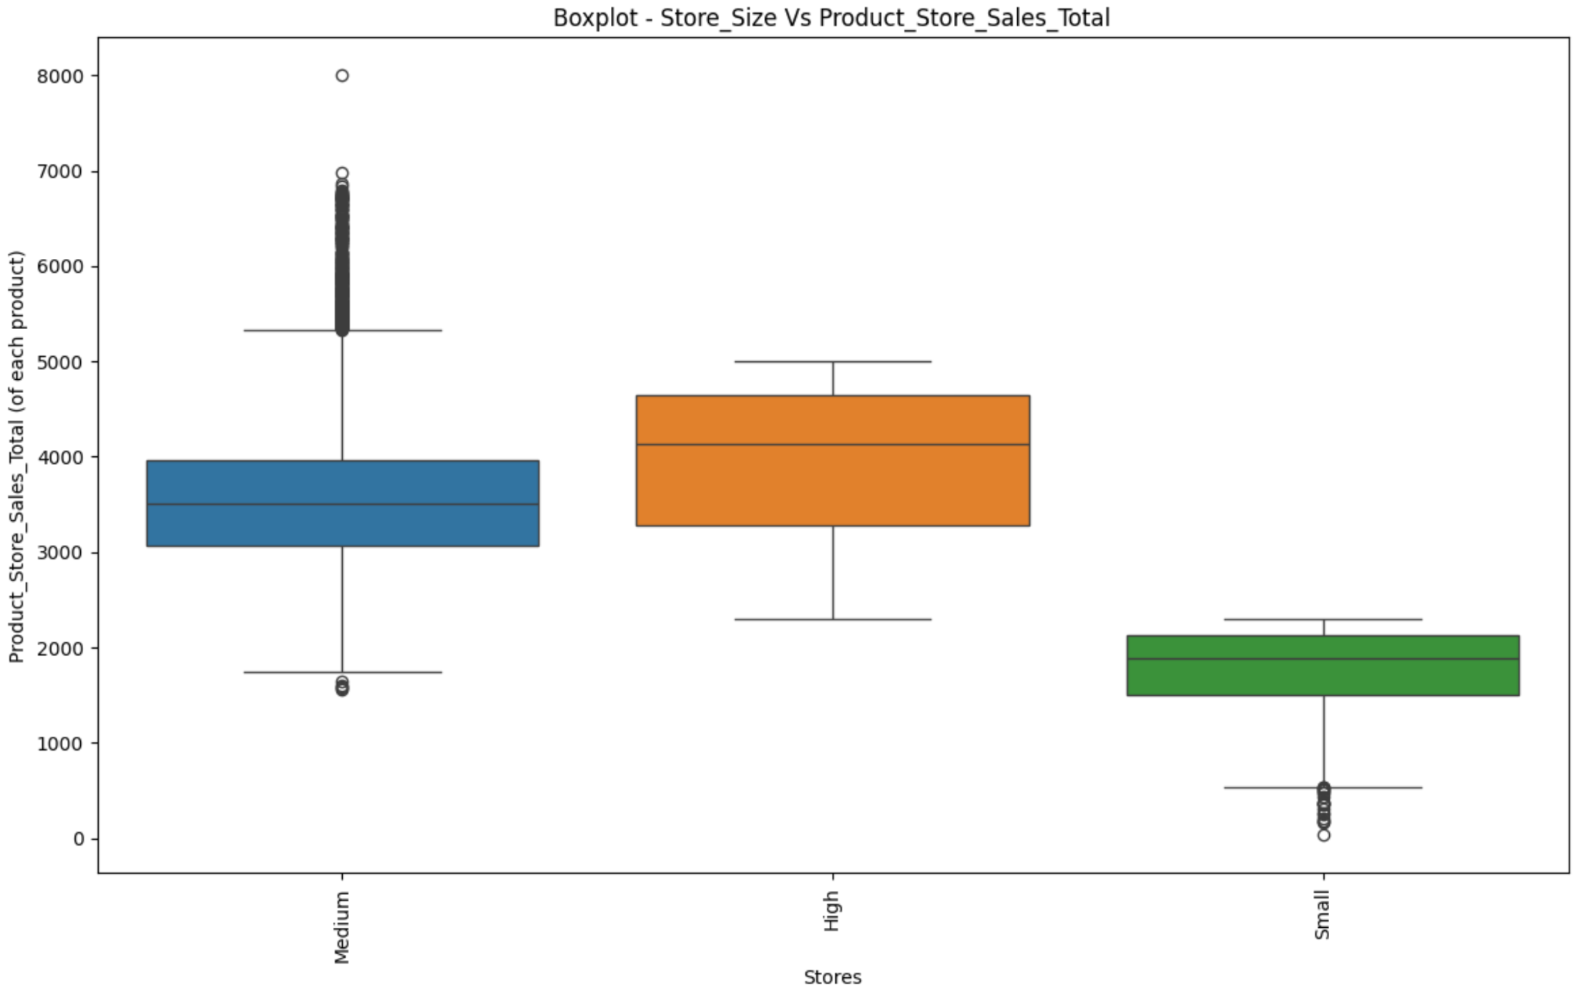
EDA Results Store Size vs Product Store Sales Total
High-size stores deliver the most consistently strong results: fewer outliers and higher range suggest operational stability and efficient assortments.
Medium-size stores show competitive median sales with a wider spread—this format might drive revenue through high-performing SKUs while requiring tighter SKU management.
Small-size stores underperform in median and show significant tail risk; these may struggle with inventory depth, local demand, or service levels.
Link to Appendix slide on data background check

Slide 35
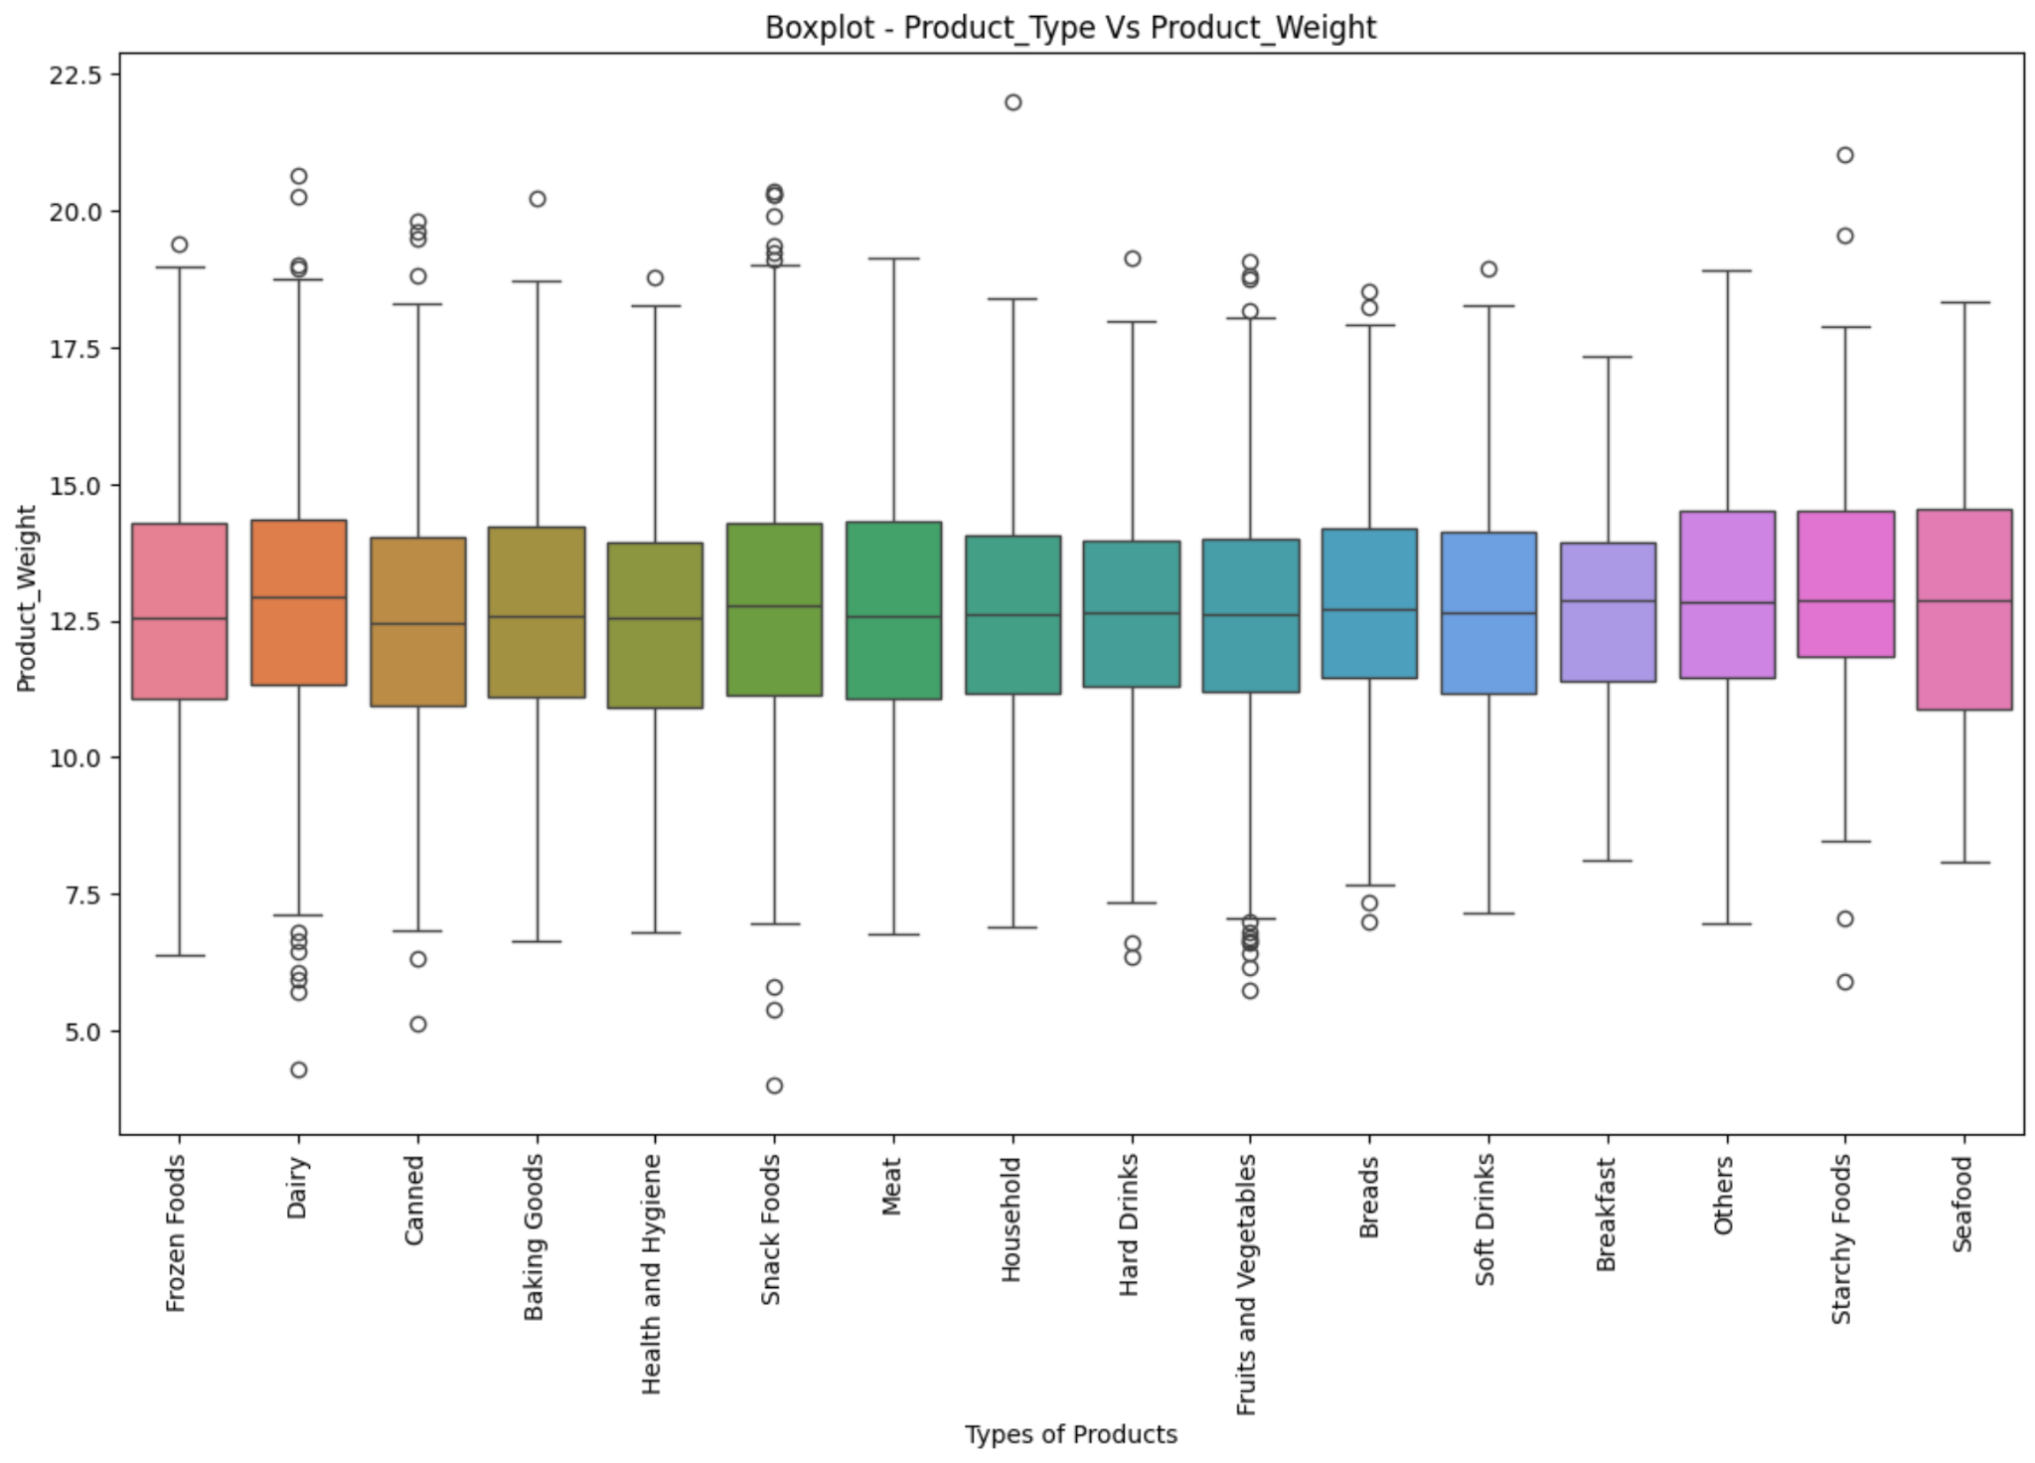
EDA Results Product Type vs Product Weight
Heterogeneous spread: Some categories show tight, consistent weights (standardized packaging); others show wide IQRs and whiskers (mixed pack sizes, item variety).
Outliers matter: Extreme heavy or light items likely reflect bulk packs, mis-labeled units, or niche SKUs; treat them explicitly instead of averaging them away.
Link to Appendix slide on data background check

Slide 36
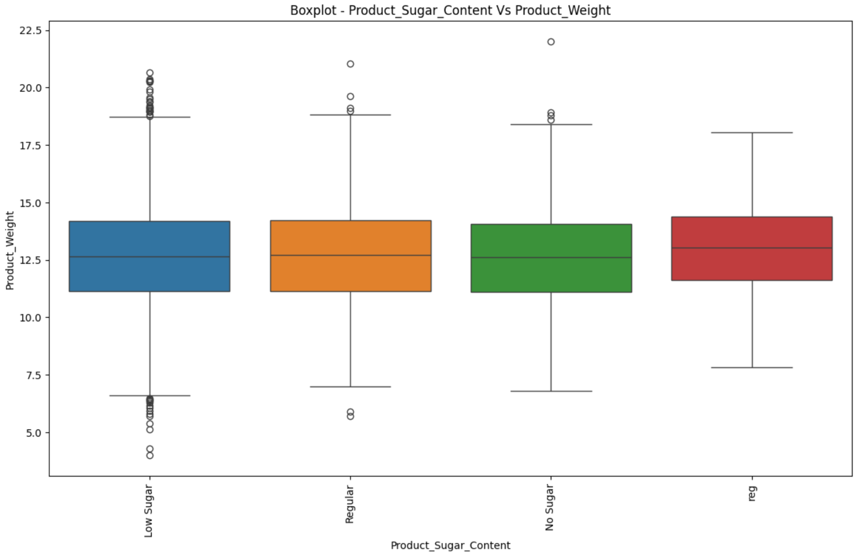
EDA Results Product Sugar Content vs Product Weight
Outlier tagging: Spot unusually heavy "No Sugar" items—may indicate mislabeled or specialty bulk packs.
Lower median, tight IQR More standardized, lightweight items—likely health or niche products
Higher median, wide IQR Diverse mix of product types—bulk items and sugary goods like drinks or cereals
Category mapping: Link sugar content to product type to see if certain categories skew the weight.
Link to Appendix slide on data background check

Slide 37
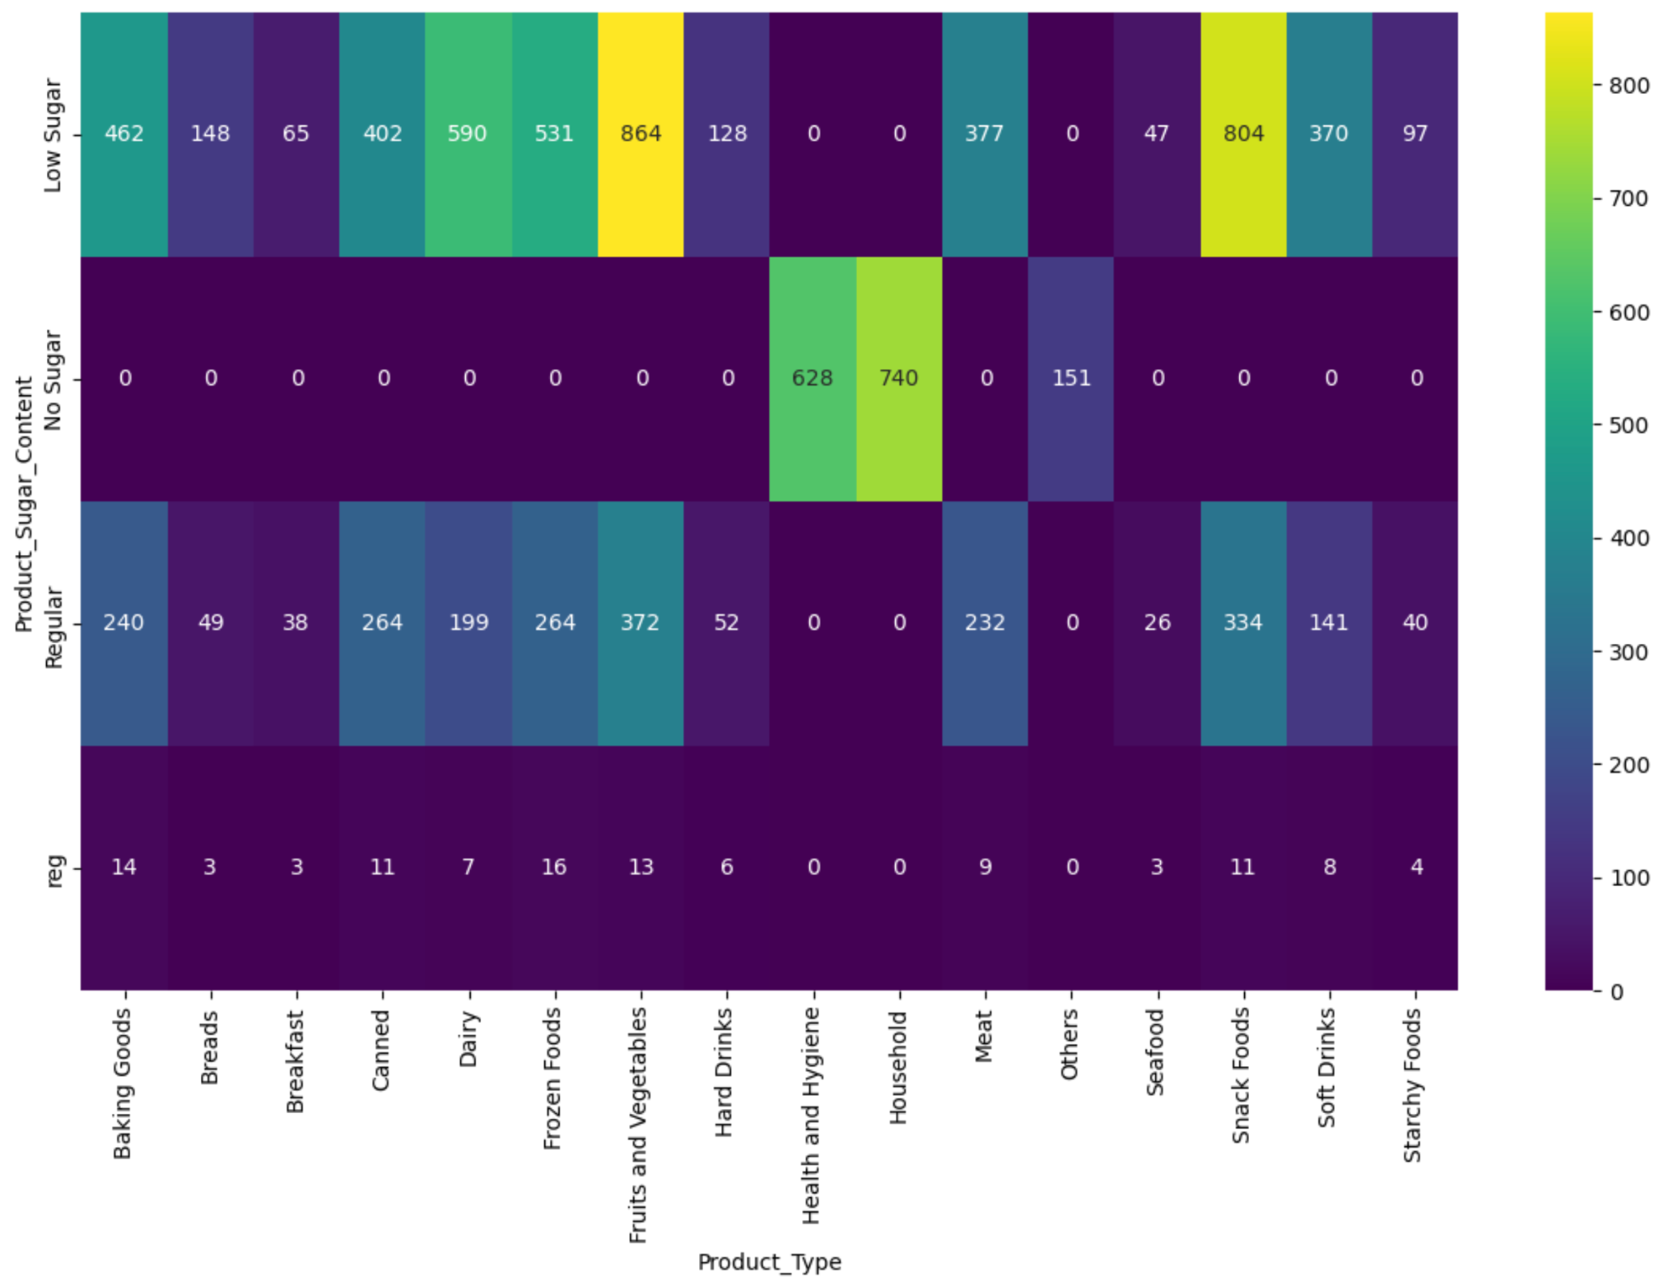
EDA Results Product Sugar Content
Strong association: Sugar content clearly isn’t random—certain product types cluster heavily in specific sugar tiers (e.g., beverages in Regular/Low/No Sugar; produce/meat in No Sugar).
Assortment insights: Expect over-indexing patterns, e.g., Soft Drinks/Breakfast/Snack Foods in Regular; Fruits & Vegetables/Meat/Seafood in No Sugar; some Low Sugar penetration in Snacks/Dairy/Frozen
Class imbalance: One or two tiers likely dominate counts (often “Regular”). Plan for imbalance in any modeling or reporting.
Link to Appendix slide on data background check

Slide 38
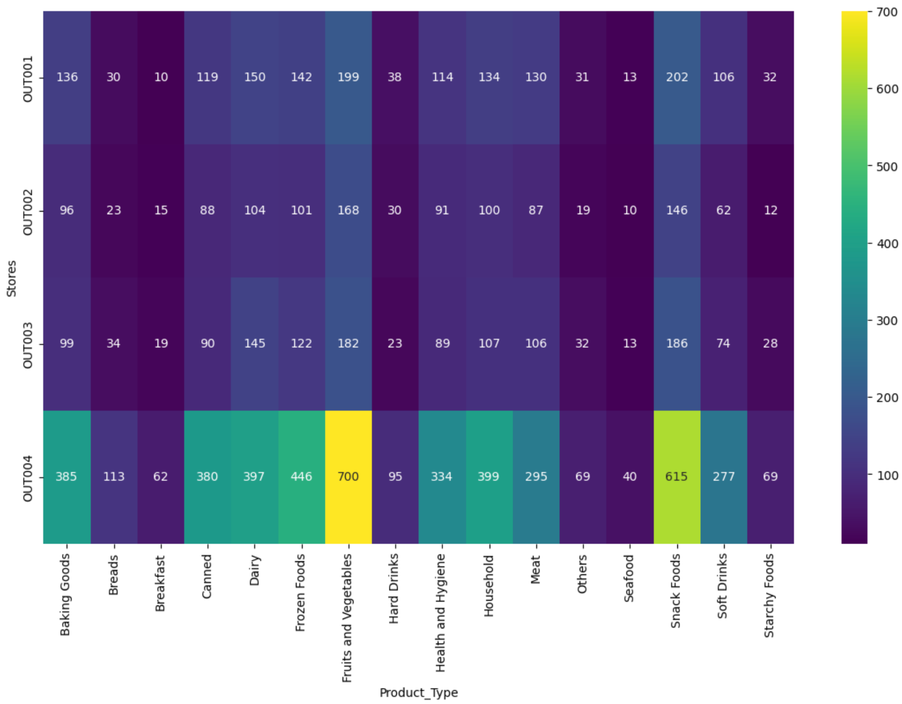
EDA Results Product Type Sold at Each Store
Sales distribution across product types for stores OUT001 through OUT004, with intensity signaling volume (lighter = higher sales)
OUT004 is the revenue leader due to strength in perishable and impulse categories; it may benefit from superior location, layout, or customer segmentation.
OUT002 shows overall underperformance, particularly in consumables—suggest auditing foot traffic, assortment strategy, and local competition.
OUT001 is driven more by snacks and drinks than staple categories, signaling possible format skew or demographic leaning.
Link to Appendix slide on data background check

Slide 39
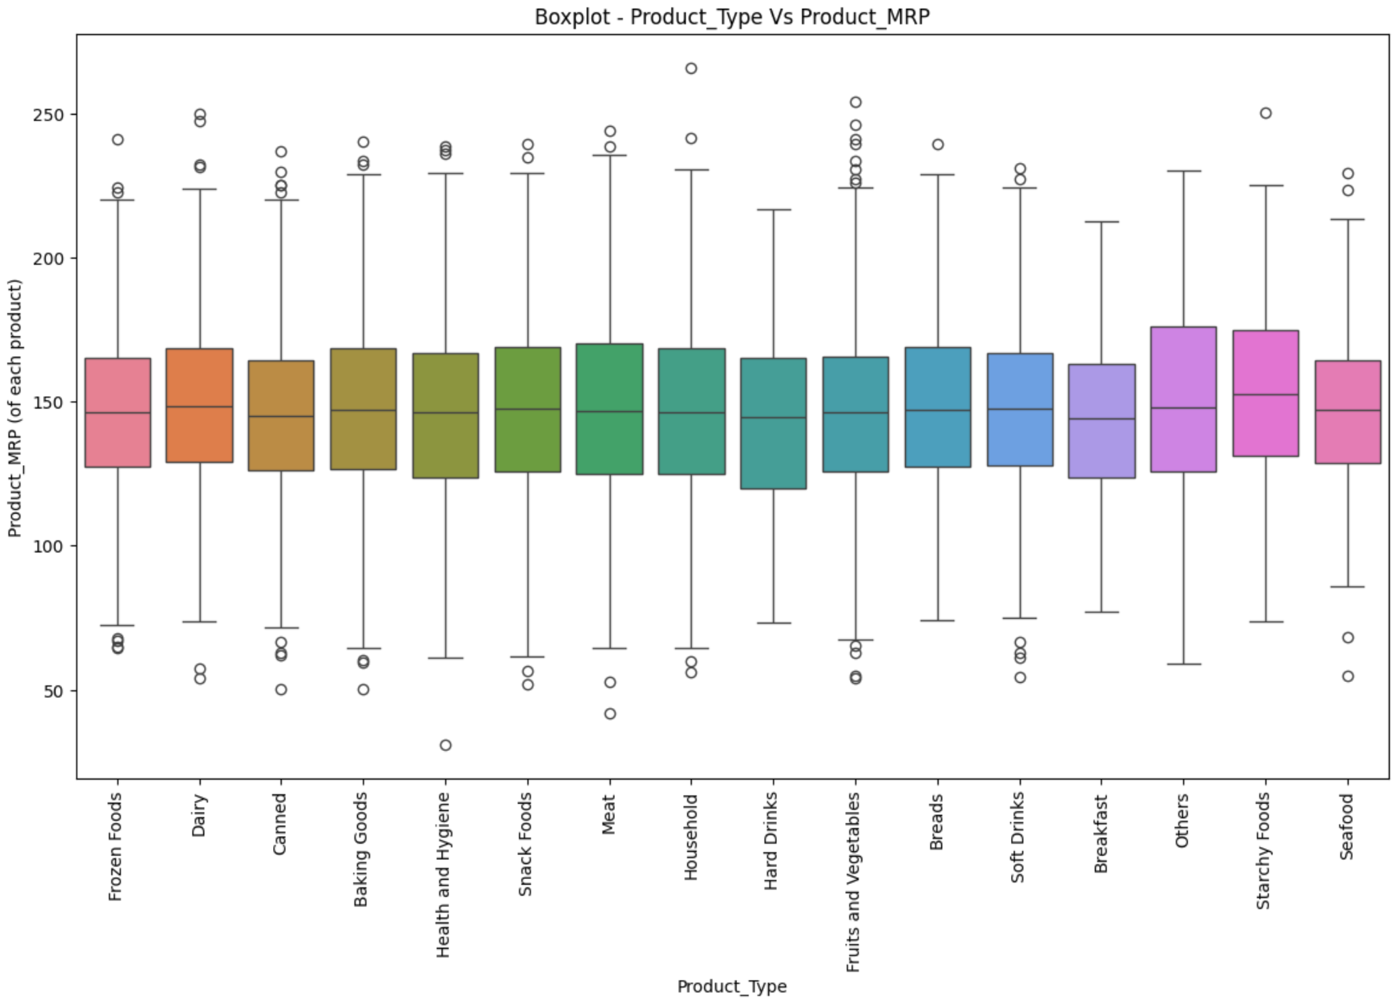
EDA Results Product Type vs Product MRP
Link to Appendix slide on data background check

Slide 40
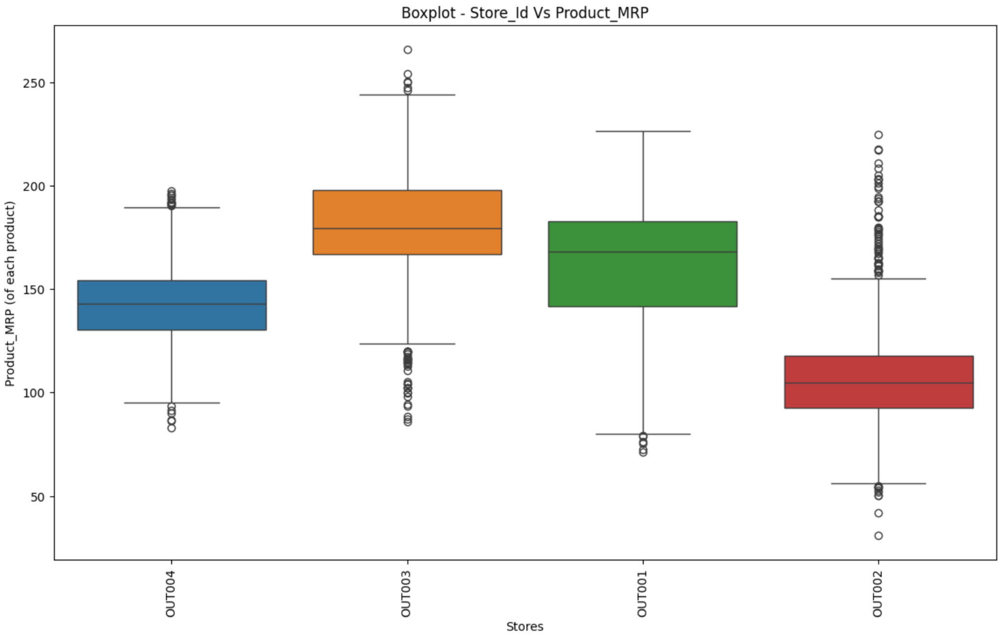
EDA Results Store Id vs Product MRP
Link to Appendix slide on data background check

Slide 41
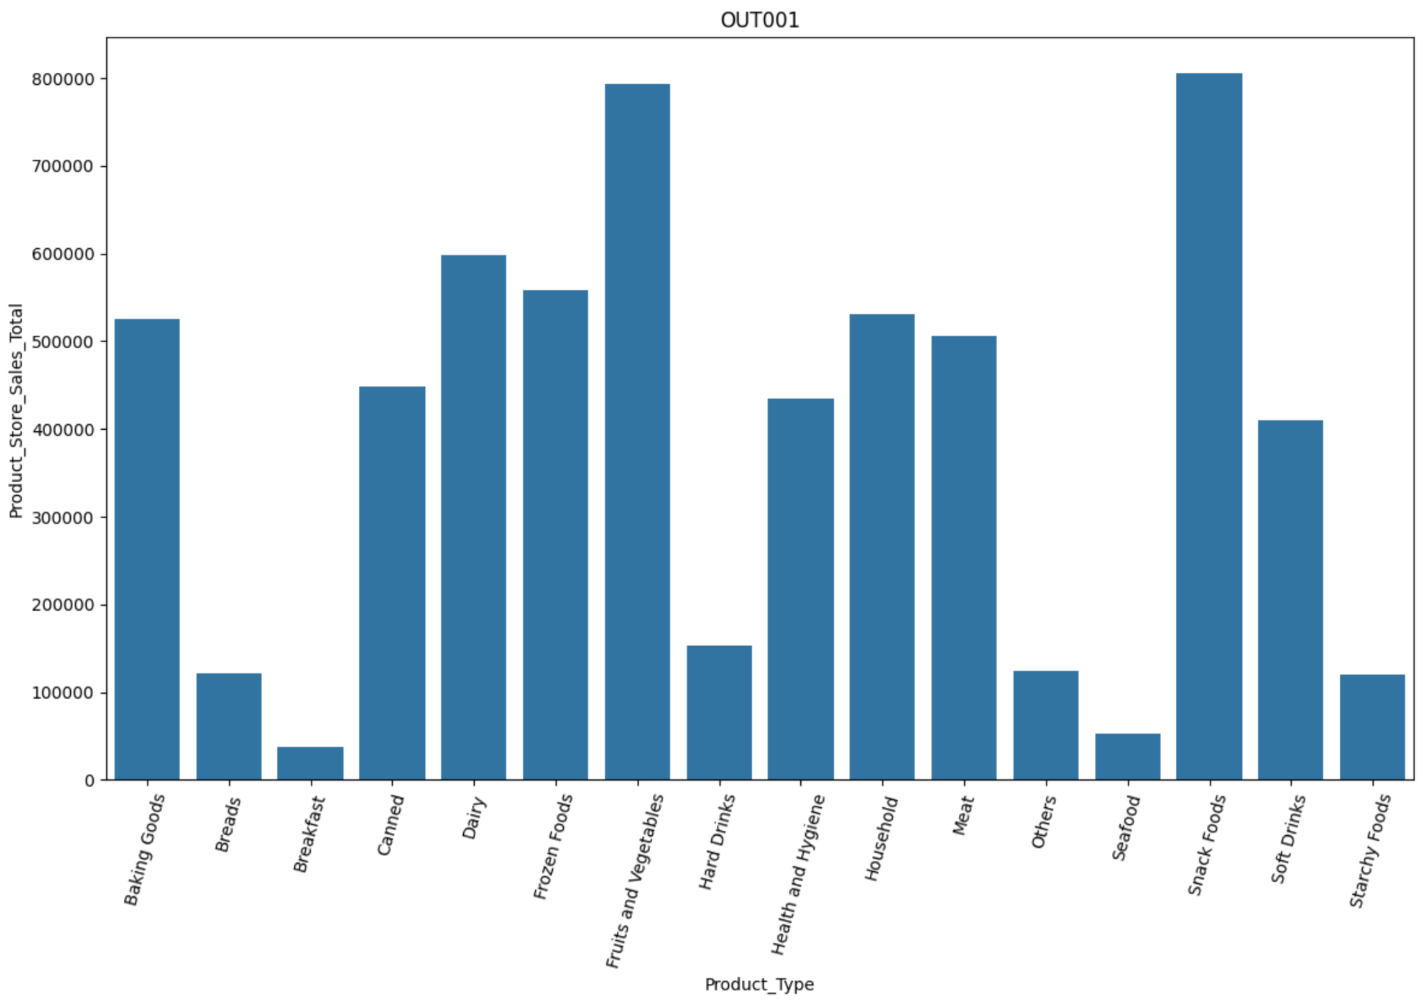
EDA Results Revenue - Product Type OUT001
Link to Appendix slide on data background check

Slide 42
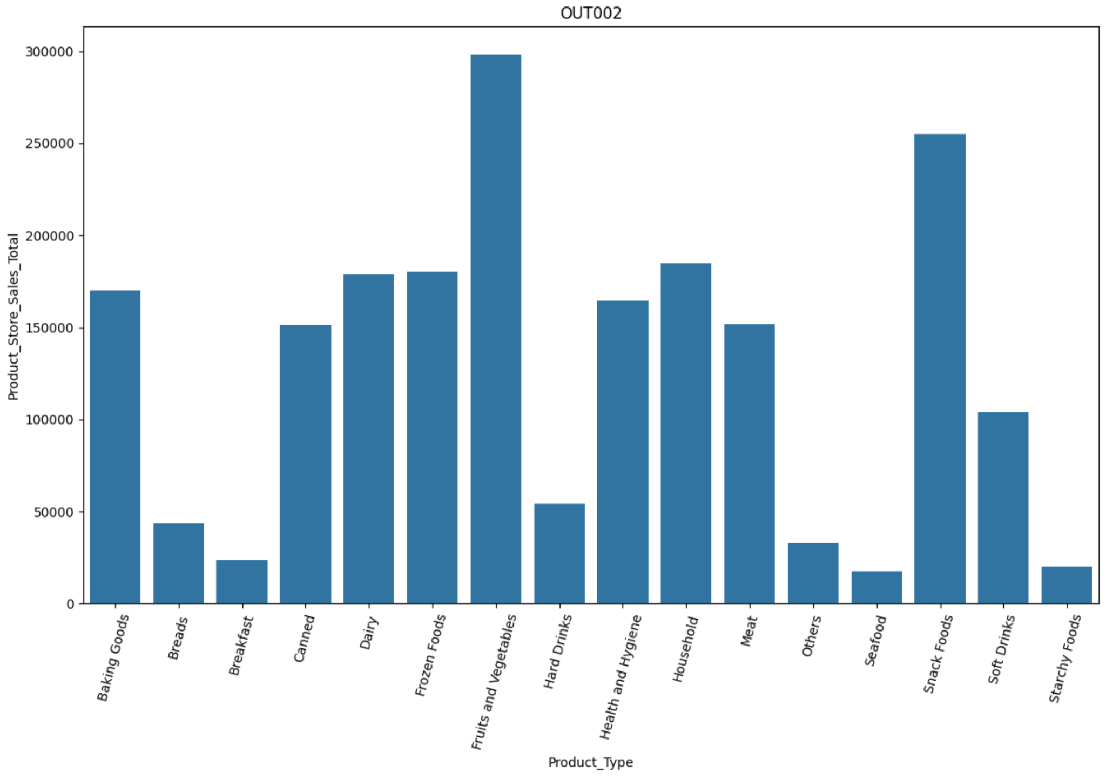
EDA Results Revenue - Product Type OUT002
Link to Appendix slide on data background check

Slide 43
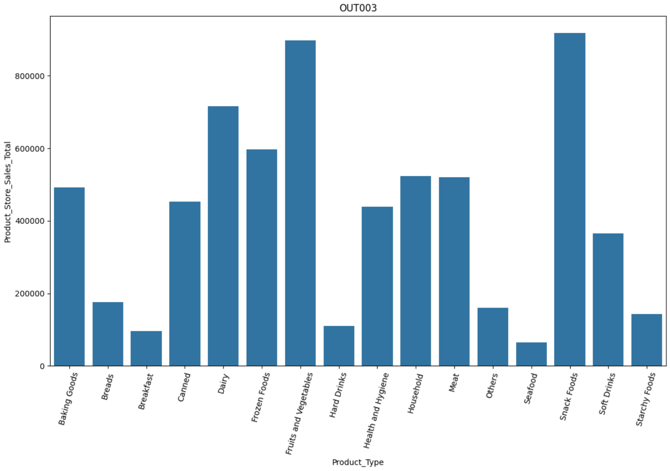
EDA Results Revenue - Product Type OUT003
Link to Appendix slide on data background check

Slide 44
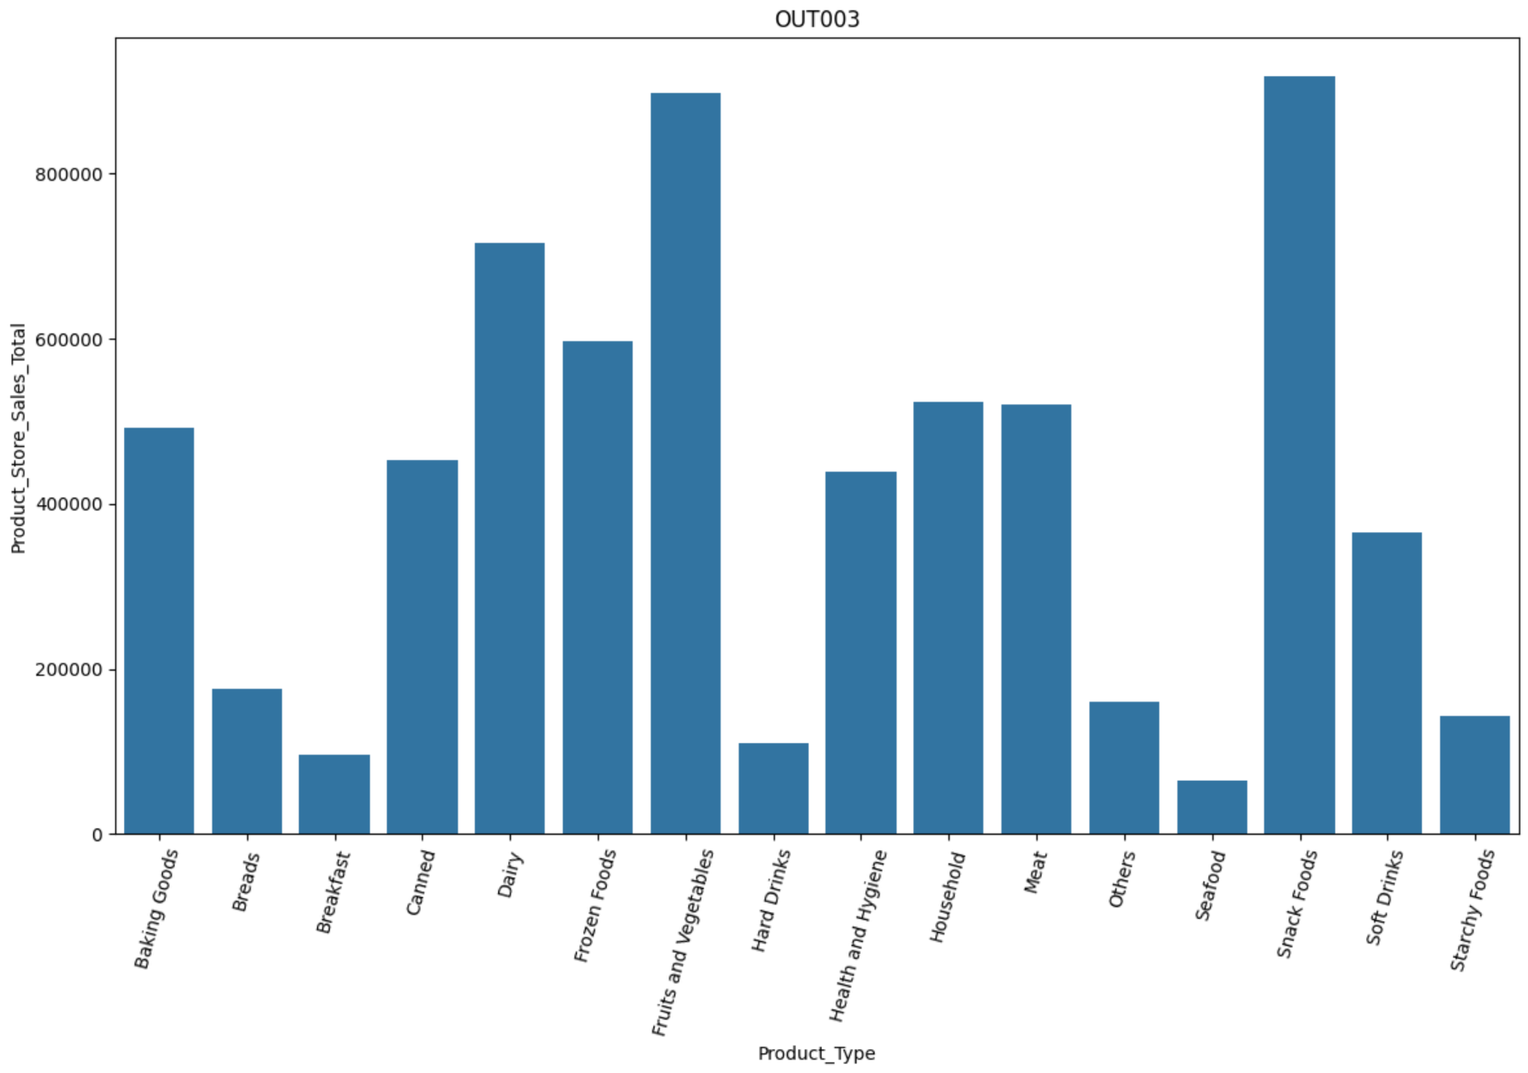
EDA Results Product Store Sales Total - OUT004
Link to Appendix slide on data background check

Slide 45
Data Preprocessing
Upon reviewing the Product Sugar Content, we identified three distinct entries: Low Sugar, Regular, and reg. It is evident that Regular and reg represent the same category. To ensure consistency and improve data quality, we will standardize the label by replacing all instances of reg with Regular
Sugar Content | Product Count
Low Sugar | 4,885
Regular | 2,359
No Sugar | 1,519

Slide 46
Data Preprocessing
The Product_Id column is structured with a two-character prefix followed by a numeric sequence. To facilitate product categorization, a new column was introduced to identify the corresponding product type. The following associations were established:
Product Type Corresponding to 'FD' Prefix
Frozen Foods | Fruits and Vegetables
Dairy | Breads
Canned | Breakfast
Baking Goods | Starchy Foods
Snack Foods | Seafood
Meat

Slide 47
Data Preprocessing
The Product_Id column is structured with a two-character prefix followed by a numeric sequence. To facilitate product categorization, a new column was introduced to identify the corresponding product type. The following associations were established:
Product Type Corresponding to 'DR' Prefix
Hard Drinks | Soft Drinks

Slide 48
Data Preprocessing
The Product_Id column is structured with a two-character prefix followed by a numeric sequence. To facilitate product categorization, a new column was introduced to identify the corresponding product type. The following associations were established:
Product Type Corresponding to 'NC' Prefix
Health and Hygenie | House Hold
Others

Slide 49
Data Preprocessing Age of Store Calculated
Stores with a long-standing presence in the market often demonstrate greater reliability compared to newly established ones. However, without ongoing investment, older stores may face infrastructure limitations. Therefore, we will calculate the store's current age and integrate this metric into our model to account for both trustworthiness and potential operational constraints.
Store Age in Years | Number of Stores
16 | 4676
26 | 1349
27 | 1152
38 | 1186

Slide 50
Data Preprocessing Product Type Category
The dataset included 16 distinct product types. To simplify the analysis, we’ll group them into two broader categories: perishables and non-perishables. This approach will help streamline insights and improve clarity.
Count of Product Type Category
Perishables | 5718
Non-perishables | 3045

Slide 51
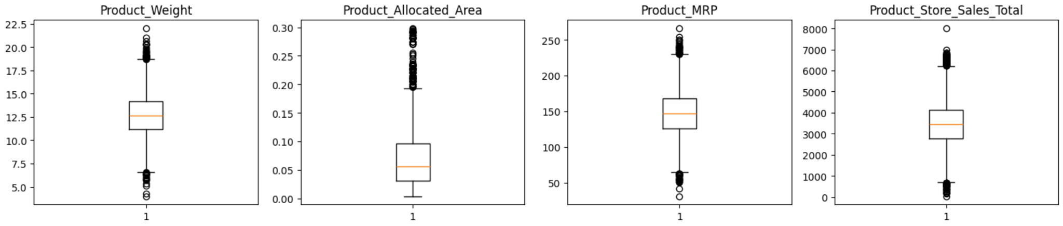
Data Preprocessing Product Weight Outliers
Product allocated Area corresponds Product weight with heavier products tend to require more allocated area due to larger packaging or storage needs.
Product MRP Outliers are associated with Product Allocated Area with larger allocated areas having higher MRPs due to premium packaging, branding, or perceived value.
Product Sales Total Outliers are associated with Product MRP with Lower-priced items often sell in higher volumes, while high-MRP items may have lower but more profitable sales.

Slide 52
Data Preprocessing
The objective is to predict the total store sales for each product. Prior to developing the model, we will remove any irrelevant columns and organize the data by converting descriptive categories into a usable format. Finally, we will divide the data into two parts: one for training the model and another for testing its accuracy on new information.
Irrelevant columns removed from dataset.
Product Id
Store Id
Store Establishment Year

Slide 53
Data Preprocessing
We recognize certain columns as containing labeled groups, such as product type or store location, and prepare them in a way that helps the model interpret each group correctly. We also set aside specific columns to prevent any changes in the data that could negatively affect the model’s accuracy.
Feature Name | Description
Product_Sugar_Content | Indicates the sugar level in the product
Store_Size | Represents the overall size of the store
Store_Location_City_Type | Describes the type of city the store is located in
Store_Type | Categorizes the store’s format or business model
Product_Id_char | Unique identifier code for each product
Product_Type_Category | Broad classification of the product type

Slide 54
Model Building Gradient Boosting Regressor
We create a pipeline that contains a sequence of steps that is performed on categorical data before feeding it into a model. The pipeline is applied to each model we build. This is the first Step.
Part | What It Means
Column Transformer | Creates a transformer that applies different processing steps to different columns.
Categorical Features Identified | A list of column names that contain categories (e.g., "Store_Type", "Product_Type").
Pipeline | A sequence of steps to apply in order. In this case, just one step: encoding.
OneHotEncoder ignoring unknown values that are not part of the dataset. This helps with data shift | Turns category labels into numbers so the model can use them. It also ignores labels that weren't seen during training.

Slide 55
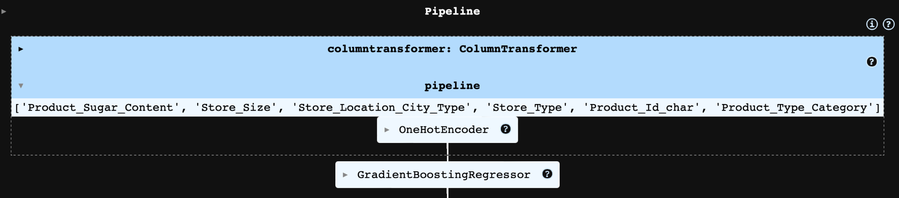
Model Building Gradient Boosting Regressor
We begin by constructing the model and integrating it with a predefined pipeline. The pipeline systematically applies each processing step in the specified order. Step names are automatically managed by the pipeline, eliminating the need for manual tracking. Once assembled, the model is trained using the designated training data.
Diagram of Pipeline for Gradient Boosting Regressor

Slide 56
Model Building Gradient Boosting Regressor Performance
R² and Adj. R²: Explains that ~68.5% of the variance in store sales. The small drop in Adjusted R² confirms that the feature set is not bloated indicates a good sign.
MAPE: A 16.6% error rate means predictions are off by ~17% on average. This is decent for retail forecasting, but there's room to push toward 10–12% with better feature engineering or model tuning.
Performance on Training Dataset - No Tuning
Metric | Value | What It Means | Ideal Direction
R-squared | 0.6850 | Proportion of variance in target explained by the model | Closer to 1
Adj. R-squared | 0.6844 | Adjusted for number of predictors; penalizes overfitting | Closer to 1
MAPE | 16.57% | Mean Absolute Percentage Error: average error as a percentage of actual values | Lower is Better

Slide 57
Model Building Gradient Boosting Regressor Performance
R² and Adj. R²: Explains that ~68.5% of the variance in store sales. The small drop in Adjusted R² confirms that the feature set is not bloated indicates a good sign.
MAPE: A 16.6% error rate means predictions are off by ~17% on average. This is decent for retail forecasting, but there's room to push toward 10–12% with better feature engineering or model tuning.
Performance on Test Dataset - No Tuning
Metric | Value | What It Means | Ideal Direction
R-squared | 0.6850 | Proportion of variance in target explained by the model | Closer to 1
Adj. R-squared | 0.6844 | Adjusted for number of predictors; penalizes overfitting | Closer to 1
MAPE | 16.57% | Mean Absolute Percentage Error: average error as a percentage of actual values | Lower is Better

Slide 58
Model Building Gradient Boosting Regressor Performance
R² and Adj. R²: Explains that ~68.5% of the variance in store sales. The small drop in Adjusted R² confirms that the feature set is not bloated indicates a good sign.
MAPE: A 16.6% error rate means predictions are off by ~17% on average. This is decent for retail forecasting, but there's room to push toward 10–12% with better feature engineering or model tuning.
Performance on Training Dataset - Tuned
Metric | Value | What It Means | Ideal Direction
R-squared | 0.6846 | Proportion of variance in target explained by the model | Closer to 1
Adj. R-squared | 0.6841 | Adjusted for number of predictors; penalizes overfitting | Closer to 1
MAPE | 16.61% | Mean Absolute Percentage Error: average error as a percentage of actual values | Lower is Better

Slide 59
Model Building Gradient Boosting Regressor Performance
Segment analysis: Break down errors by store type, region, or product category to find where the model struggles by listing importance feature to identify noise
Performance on Testing Dataset - Tuned
Metric | Value | What It Means | Ideal Direction
R-squared | 0.6688 | Proportion of variance in target explained by the model | Closer to 1
Adj. R-squared | 0.6676 | Adjusted for number of predictors; penalizes overfitting | Closer to 1
MAPE | 18.77% | A rise here suggests worsening relative accuracy. | Lower is Better

Slide 60
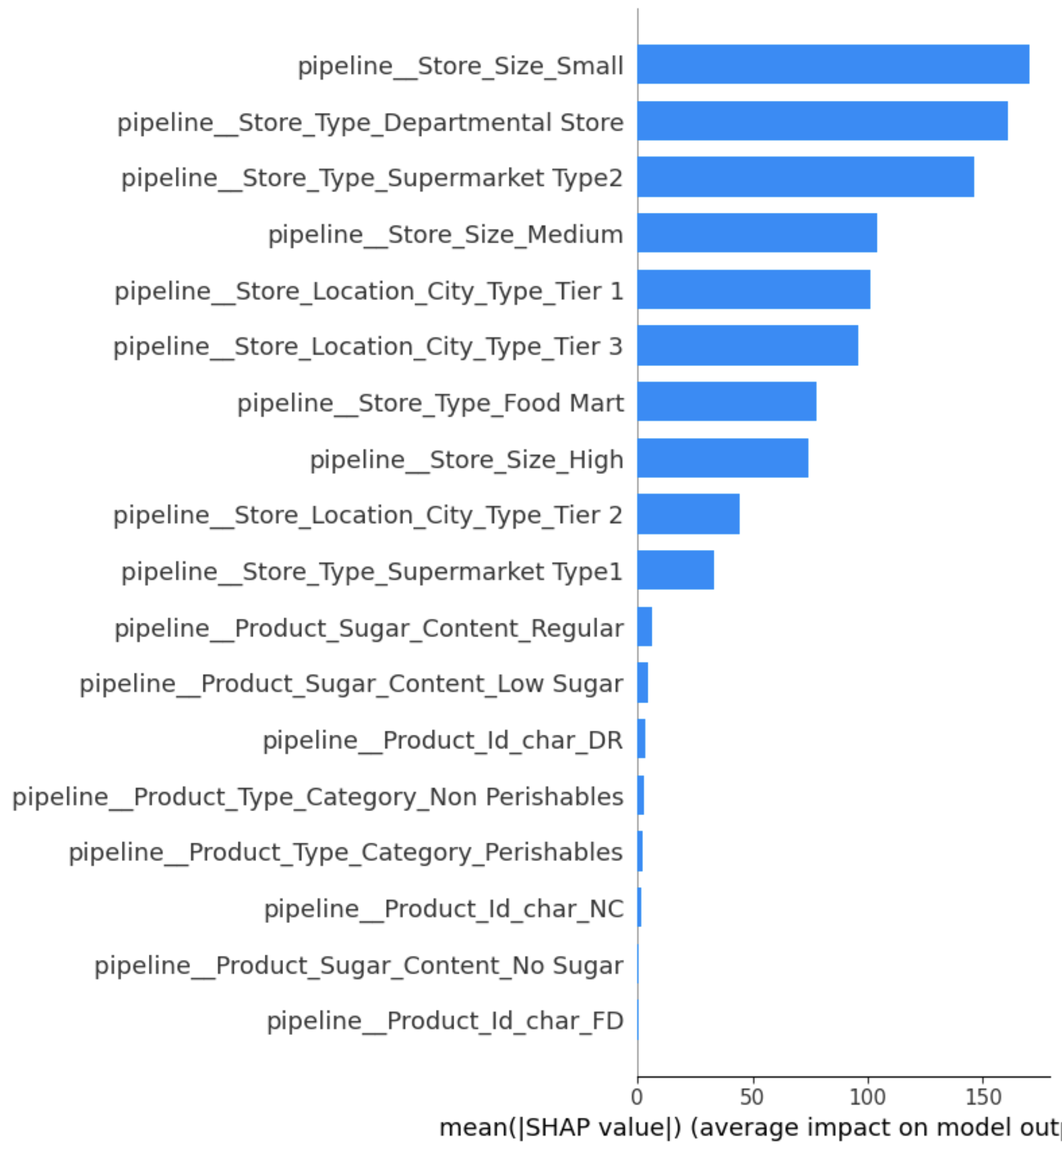
Model Building Tuned Gradient Boosting Feature of Importance
pipeline__Store_Size_Small and pipeline__Store_Size_Medium ranked highest, suggesting smaller and medium-sized stores are strong drivers in predicting sales performance.
Types like Departmental Store, Supermarket Type2, and Food Mart show high importance—each retail format likely influences sales dynamics in unique ways
Entries like Product_Id_char_DR, FD, and NC likely capture latent category signals (e.g., brands, packaging, or regulatory classification), even though they’re encoded as character flags.
Product_Type_Category_Perishables and Non Perishables appear lower but still impactful—likely due to differences in shelf life, demand variability, and restocking logistics

Slide 61
Model Building XGBoost Regressor
The same preprocessing pipeline that was use for Gradient Boost Regressor model was used for XGBoost Regressor Model.
For XGBoost we build types of models, a standard XGBoost model without any hyper-parameters. The second model was built with hyper-parameters for fine tuning.
XGBoost was implemented as a model without and with Hyper-Parameters The tune model used the following parameters.
N_estimators
Subsample
Gamma
Colsample bytree
Colsample bylevel

Slide 62
Model Building XGBoost Regressor Performance
Solid baseline: The model is capturing a significant portion of the variance in the data (~68.5%), which is promising without extensive tuning
MAPE within tolerance: For business forecasting tasks, a MAPE under 20% is often usable, but there's room for improvement toward ~12–14% through feature refinement or boosting techniques.
Performance on Training Dataset - Not Tuned
Metric | Value | What It Means | Ideal Direction
R-squared | 0.6850 | Explains ~68.5% of target variance—reasonable model fit. | Closer to 1
Adjusted R-squared | 0.6845 | Slightly lower than R², indicating the feature set is not overfitted. | Closer to 1
MAPE | 16.56% | Predictions are off by ~16.6% on average—moderate error for retail forecasting. | Lower is Better

Slide 63
Model Building XGBoost Regressor Performance
Solid baseline: The model is capturing a significant portion of the variance in the data (~66.%), which is promising without extensive tuning
MAPE within tolerance: For business forecasting tasks, a MAPE under 20% is often usable, but there's room for improvement toward ~12–14% through feature refinement or boosting techniques.
Performance on Test Dataset - Not Tuned
Metric | Value | What It Means | Ideal Direction
R-squared | 0.6684 | Explains ~66.8% of target variance—reasonable model fit. | Closer to 1
Adjusted R-squared | 0.6672 | Slightly lower than R², indicating the feature set is not overfitted. | Closer to 1
MAPE | 18.74% | Predictions are off by ~18.7% on average—moderate error for retail forecasting. | Lower is Better

Slide 64
Model Building XGBoost Regressor Performance
Solid baseline: The model is capturing a significant portion of the variance in the data (~66.%), which is promising without extensive tuning
MAPE within tolerance: For business forecasting tasks, a MAPE under 20% is often usable, but there's room for improvement toward ~12–14% through feature refinement or boosting techniques.
Performance on Training Dataset - Tuned
Metric | Value | What It Means | Ideal Direction
R-squared | 0.6684 | Explains ~66.8% of target variance—reasonable model fit. | Closer to 1
Adjusted R-squared | 0.6672 | Slightly lower than R², indicating the feature set is not overfitted. | Closer to 1
MAPE | 18.74% | Predictions are off by ~18.7% on average—moderate error for retail forecasting. | Lower is Better

Slide 65
Model Building XGBoost Regressor Performance
Solid baseline: The model is capturing a significant portion of the variance in the data (~66.%), which is promising without extensive tuning
MAPE within tolerance: For business forecasting tasks, a MAPE under 20% is often usable, but there's room for improvement toward ~12–14% through feature refinement or boosting techniques.
Performance on Test Dataset - Tuned
Metric | Value | What It Means | Ideal Direction
R-squared | 0.6684 | Explains ~66.8% of target variance—reasonable model fit. | Closer to 1
Adjusted R-squared | 0.6672 | Slightly lower than R², indicating the feature set is not overfitted. | Closer to 1
MAPE | 18.74% | Predictions are off by ~18.7% on average—moderate error for retail forecasting. | Lower is Better

Slide 66
Model Performance Comparison Training Summary
Summary of key performance metrics for training data in tabular format for comparison
All models perform closely—minimal variance across metrics.
GB Tuned Train shows a marginal increase in error metrics post-tuning, which might call for a revisit of the search space or regularization parameters.
 | GB Estimator Train | GB Tuned Train | XGB Estimator Train | XGB Tuned Train
R-squared | 0.685004 | 0.684405 | 0.685033 | 0.684850
Adj. R-squared | 0.684489 | 0.683890 | 0.684519 | 0.684335
MAPE | 0.165730 | 0.166445 | 0.165690 | 0.16557

Slide 67
Model Performance Comparison Test Summary
Summary of key performance metrics for training data in tabular format for comparison
GB Tuned Test edges out the others slightly on RMSE and R², suggesting minimal but real benefit from tuning.
Across the board, performance differences are slim—indicating consistent generalization.
 | GB Estimator Test | GB Tuned Test | XGB Estimator Test | XGB Tuned Test
R-squared | 0.668515 | 0.668958 | 0.668482 | 0.668005
Adj. R-squared | 0.667249 | 0.667693 | 0.667215 | 0.666737
MAPE | 0.187447 | 0.188043 | 0.187421 | 0.187424

Slide 68
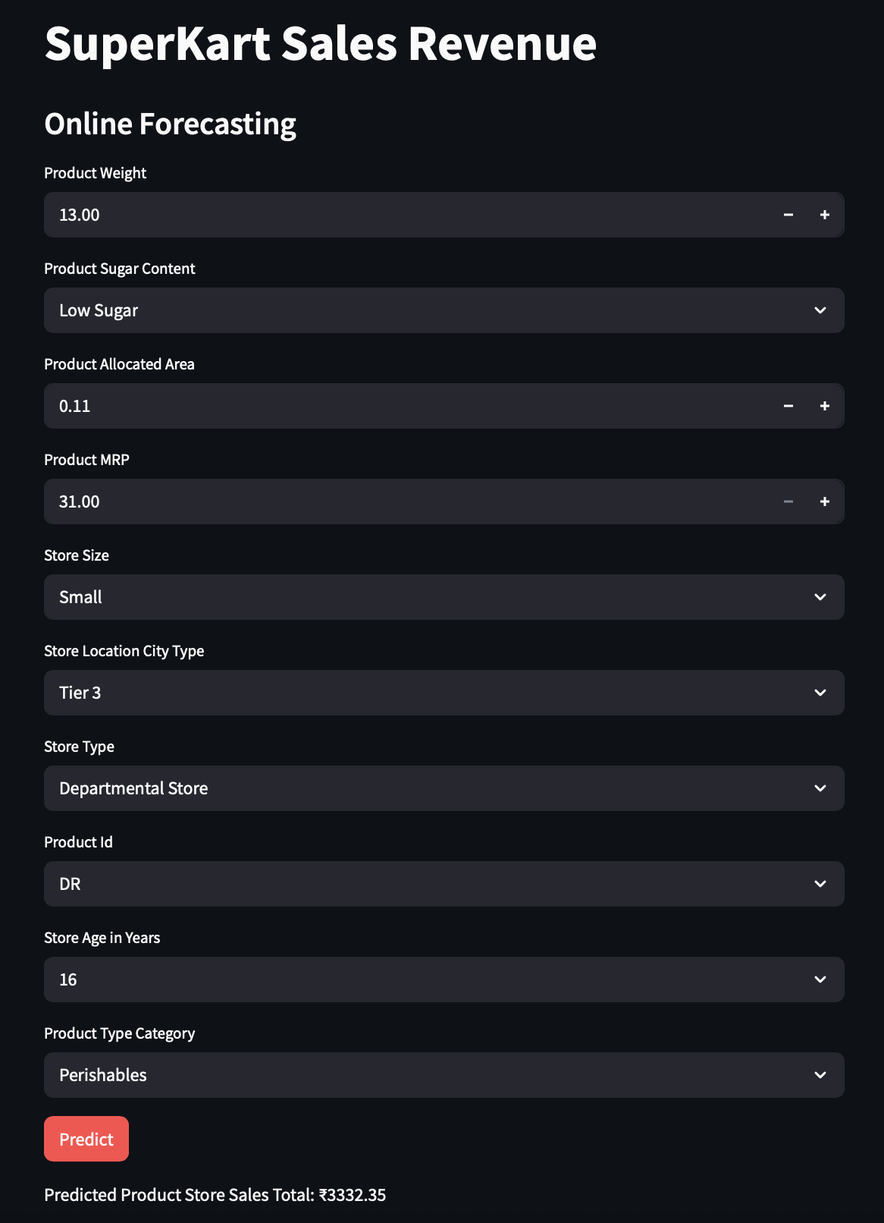
Deployment Frontend API
The Frontend application is hosted on Hugging Face
The frontend user Interface allows the user to select different features to make forecast prediction.
After choosing options and clicking on Predict. The revenue forecast is displayed on screen to the user
Frontend Deployment

Slide 69

Deployment Backend API
The Backend API is hosted on Hugging Face
The backend deployment api only displays a welcome message to the user. Welcome to SuperKart Forecast API
Backend Deployment

Slide 70
Data Background and Contents
Feature Name | Description
Product_Id | Unique identifier for each product; begins with two letters followed by a number (e.g., "PR123").
Product_Weight | Weight of the product, typically measured in kilograms or grams.
Product_Sugar_Content | Sugar level classification: Low Sugar, Regular, or No Sugar.
Product_Allocated_Area | Ratio of the display area allocated to the product relative to the total display area in the store.
Product_Type | Broad product category, such as: Meat, Snack Foods, Hard Drinks, Dairy, Canned, Soft Drinks, Health & Hygiene, Baking Goods, Bread, Breakfast, Frozen Foods, Fruits & Vegetables, Household, Seafood, Starchy Foods, Others.
Product_MRP | Maximum Retail Price of the product.
Store_Id | Unique identifier for each store.
Store_Establishment_Year | Year the store was established.

Slide 71
Appendix
Feature Name | Description
Store_Size | Store size classification based on square footage: High, Medium, or Low.
Store_Location_City_Type | City classification: Tier 1, Tier 2, or Tier 3. Tier 1 cities have a comparatively higher standard of living.
Store_Type | Store format based on product offerings: Departmental Store, Supermarket Type 1, Supermarket Type 2, or Food Mart.
Product_Store_Sales_Total | Total revenue generated from the sale of the specific product in the specific store.

Slide 72
Appendix Revenue by Product
Product Type | Store Id | Sales Revenue
Baking Goods | OUT001 | $525,131.04
Baking Goods | OUT002 | $169,860.50
Baking Goods | OUT003 | $491,908.20
Baking Goods | OUT004 | $1,266,086.26
Breads | OUT001 | $121,274.09
Breads | OUT002 | $43,419.47
Breads | OUT003 | $175,391.93
Breads | OUT004 | $374,856.75
Breakfast | OUT001 | $38,161.10
Breakfast | OUT002 | $23,396.10

Slide 73
Appendix Revenue by Product
Product Type | Store Id | Sales Revenue
Breakfast | OUT003 | $95,634.08
Breakfast | OUT004 | $204,939.13
Canned | OUT001 | $449,016.38
Canned | OUT002 | $151,467.66
Canned | OUT003 | $452,445.17
Canned | OUT004 | $1,247,153.50
Dairy | OUT001 | $598,767.62
Dairy | OUT002 | $178,888.18
Dairy | OUT003 | $715,814.94
Dairy | OUT004 | $1,318,447.30

Slide 74
Appendix Revenue by Product
Product Type | Store Id | Sales Revenue
Frozen Foods | OUT001 | $558,556.81
Frozen Foods | OUT002 | $180,295.95
Frozen Foods | OUT003 | $597,608.42
Frozen Foods | OUT004 | $1,473,519.65
Fruits and Vegetables | OUT001 | $792,992.59
Fruits and Vegetables | OUT002 | $298,503.56
Fruits and Vegetables | OUT003 | $897,437.46
Fruits and Vegetables | OUT004 | $2,311,899.66
Hard Drinks | OUT001 | $152,920.74
Hard Drinks | OUT002 | $54,281.85

Slide 75
Appendix Revenue by Product
Product Type | Store Id | Sales Revenue
Hard Drinks | OUT003 | $110,760.30
Hard Drinks | OUT004 | $307,851.73
Health and Hygiene | OUT001 | $435,005.31
Health and Hygiene | OUT002 | $164,660.81
Health and Hygiene | OUT003 | $439,139.18
Health and Hygiene | OUT004 | $1,124,901.91
Household | OUT001 | $531,371.38
Household | OUT002 | $184,665.65
Household | OUT003 | $523,981.64
Household | OUT004 | $1,324,721.50

Slide 76
Appendix Revenue by Product
Product Type | Store Id | Sales Revenue
Meat | OUT001 | $505,867.28
Meat | OUT002 | $151,800.01
Meat | OUT003 | $520,939.68
Meat | OUT004 | $950,604.97
Others | OUT001 | $123,977.09
Others | OUT002 | $32,835.73
Others | OUT003 | $159,963.75
Others | OUT004 | $224,719.73
Seafood | OUT001 | $52,936.84
Seafood | OUT002 | $17,663.35

Slide 77
Appendix Revenue by Product
Product Type | Store Id | Sales Revenue
Seafood | OUT003 | $65,337.48
Seafood | OUT004 | $136,466.37
Snack Foods | OUT001 | $806,142.24
Snack Foods | OUT002 | $255,317.57
Snack Foods | OUT003 | $918,510.44
Snack Foods | OUT004 | $2,009,026.70
Soft Drinks | OUT001 | $410,548.69
Soft Drinks | OUT002 | $103,808.35
Soft Drinks | OUT003 | $365,046.30
Soft Drinks | OUT004 | $917,641.38

Slide 78
Appendix Revenue by Product
Product Type | Store Id | Sales Revenue
Starchy Foods | OUT001 | $120,443.98
Starchy Foods | OUT002 | $20,044.98
Starchy Foods | OUT003 | $143,538.60
Starchy Foods | OUT004 | $234,746.89

Slide 79
Appendix Revenue by Product Sugar Content
Product Type | Store Id | Sales Revenue
Low Sugar | OUT001 | $3,300,834.93
Low Sugar | OUT002 | $1,156,758.85
Low Sugar | OUT003 | $3,706,903.24
Low Sugar | OUT004 | $8,658,908.78
No Sugar | OUT001 | $1,090,353.78
No Sugar | OUT002 | $382,162.19
No Sugar | OUT003 | $1,123,084.57
No Sugar | OUT004 | $2,674,343.14
Regular | OUT001 | $1,749,444.51
Regular | OUT002 | $472,112.50

Slide 80
Appendix Revenue by Product Sugar Content
Product Type | Store Id | Sales Revenue
Regular | OUT003 | $1,743,566.35
Regular | OUT004 | $3,902,547.93
Regular | OUT001 | $82,479.96
Regular | OUT002 | $19,876.18
Regular | OUT003 | $99,903.41
Regular | OUT004 | $191,783.58

